Slide 1
GLayout: A Pythonic Framework for Analog Layout Design
Anhang Li (anhangli@umich.edu)
Mehdi Saligane (mehdi@umich.edu)

Slide 2
Outline
Introduction
GLayout Setup & Design Walkthrough
Running DRC, LVS, and Post-Layout Simulations
Real-World Application Example

Slide 3
Introduction

Slide 4
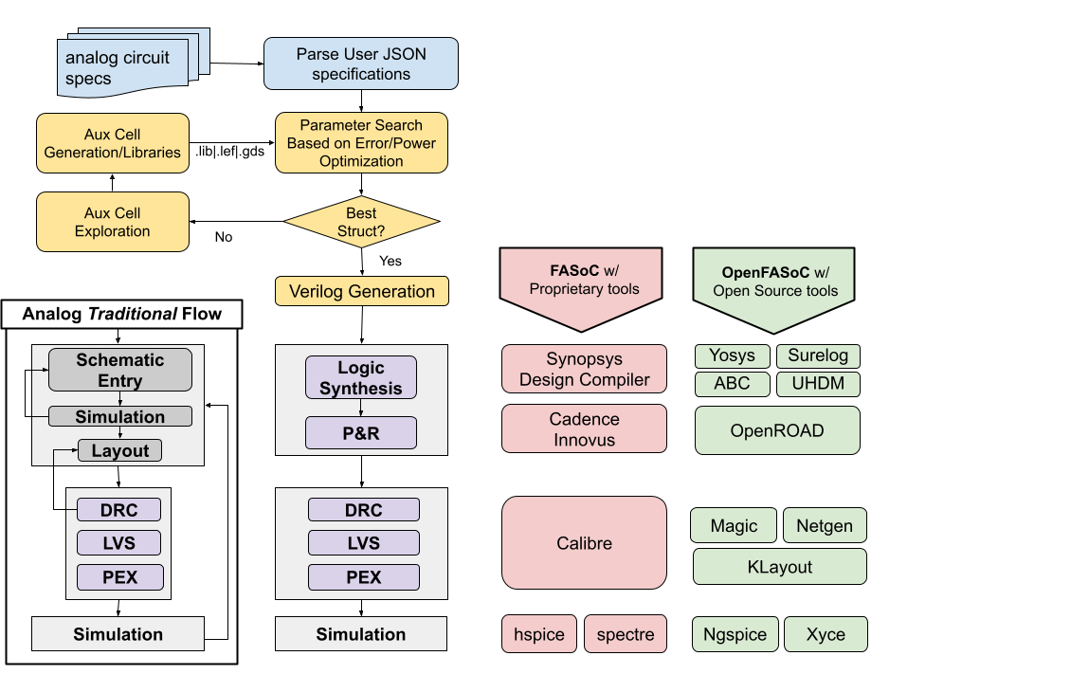
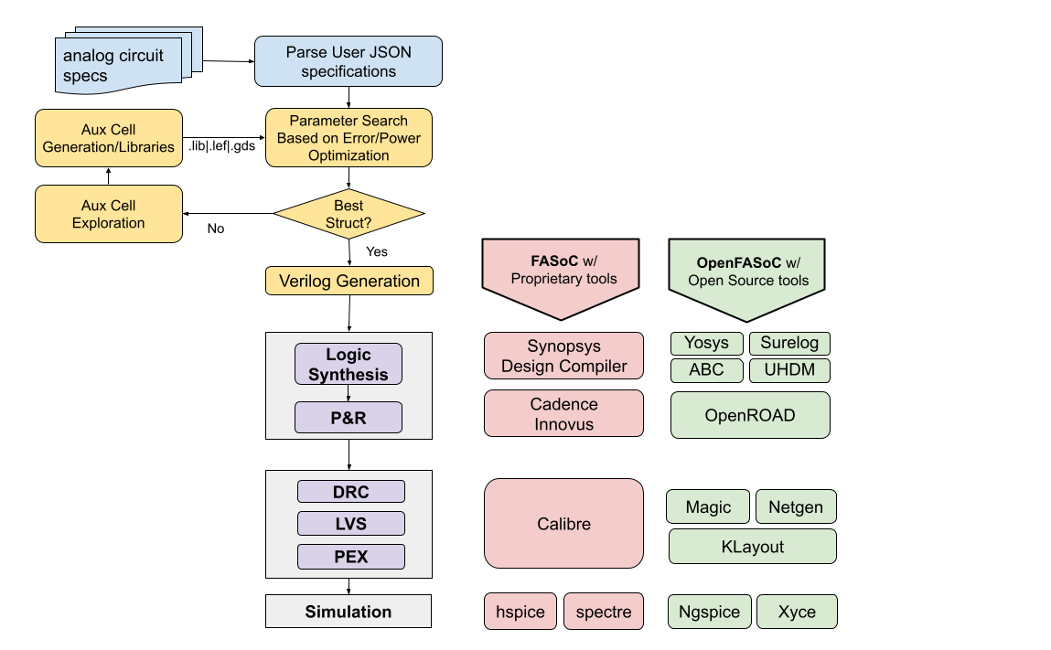
Analog vs. Digital design flow
Automated
Manual/Custom
Analog design flow Significant number of manual and custom steps.
Digital design flow Almost entirely automated.
Notes:
I made a small workflow diagram on the left of what would be a traditional analog layout flow today.
As you all know, most of it is custom and require multiple iterations from schematic entry to layout then simulation and so forth. While the digital flow (or a grid based flow) is highly automated for a while now. So the idea is to basically take what would otherwise be a full custom analog layout and shoehorn it into the cell based digital automated design flow methodology which is pretty amenable to the available logic synthesis and P&R tools be it proprietary and even better open source tools.

Slide 5
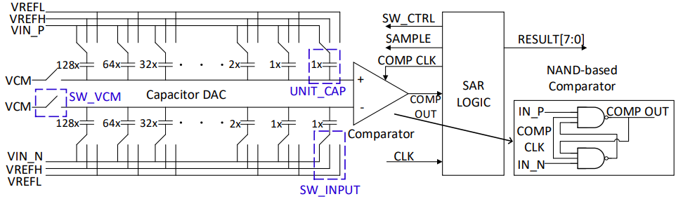
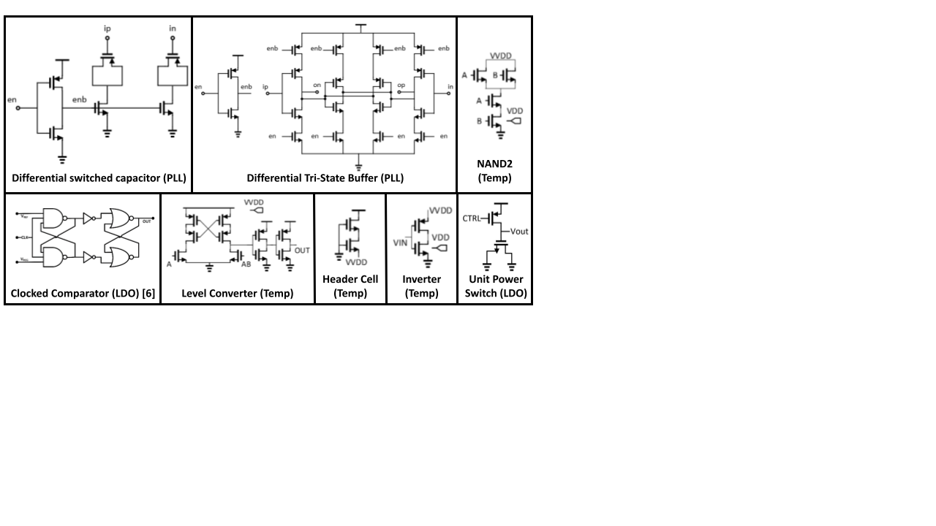

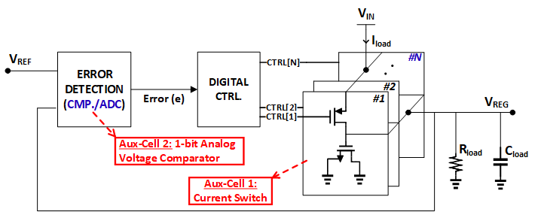
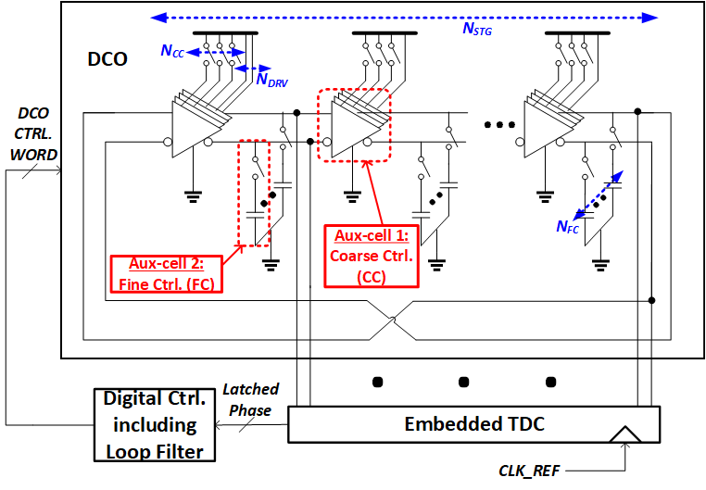
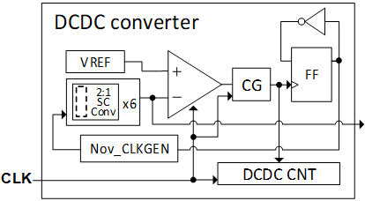
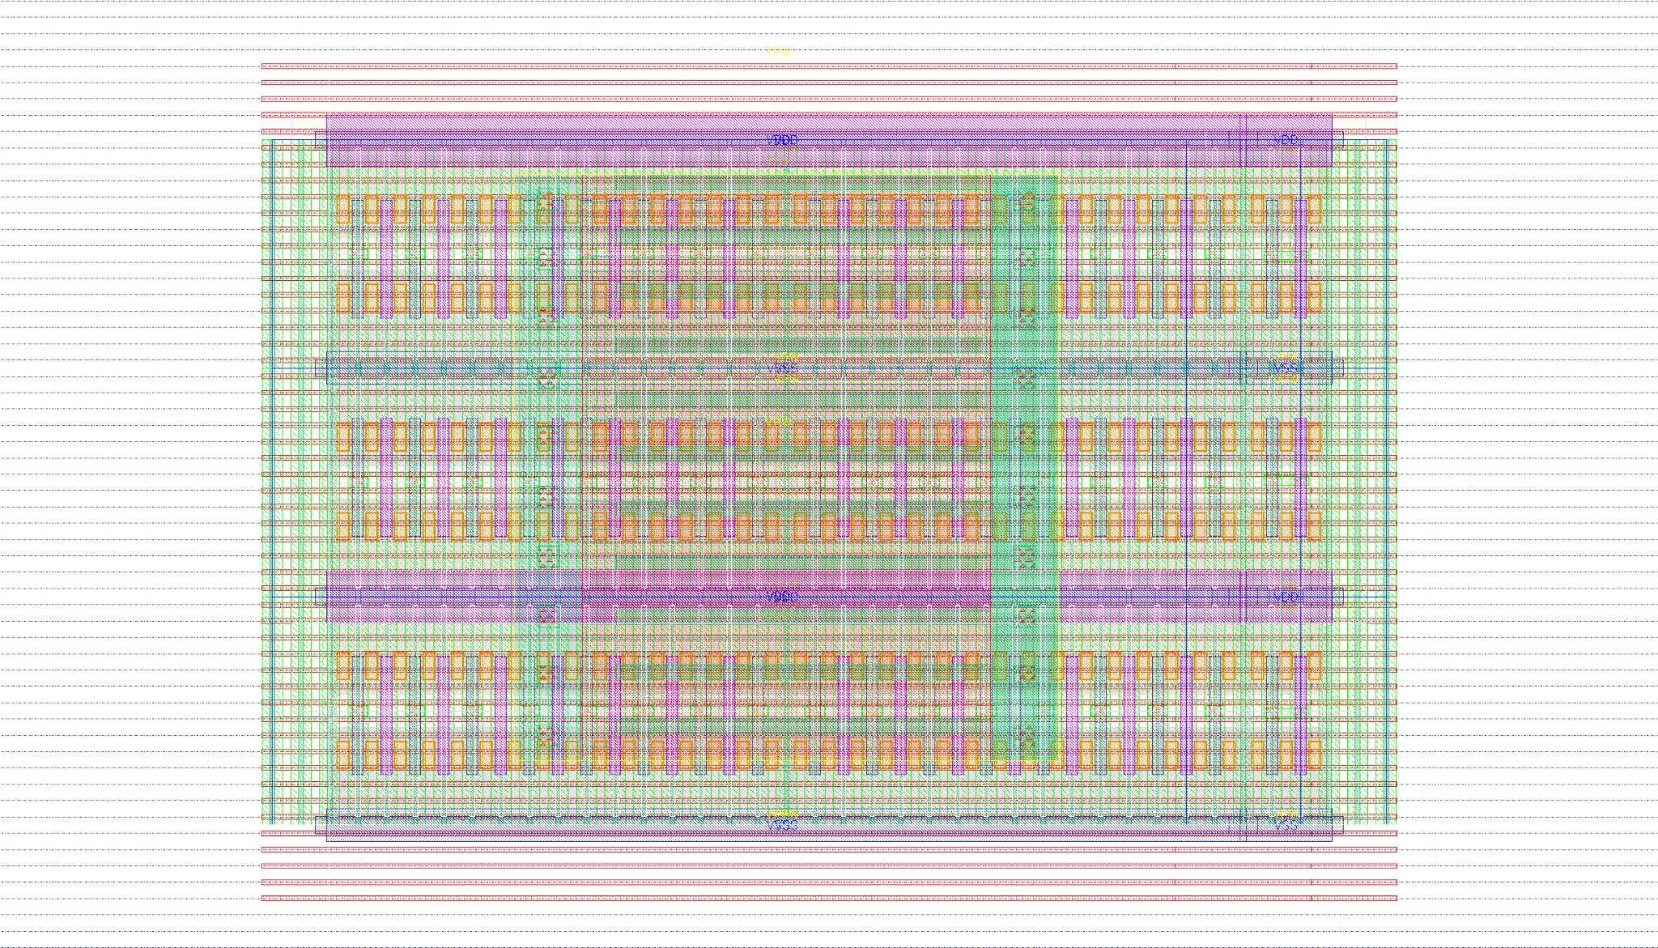
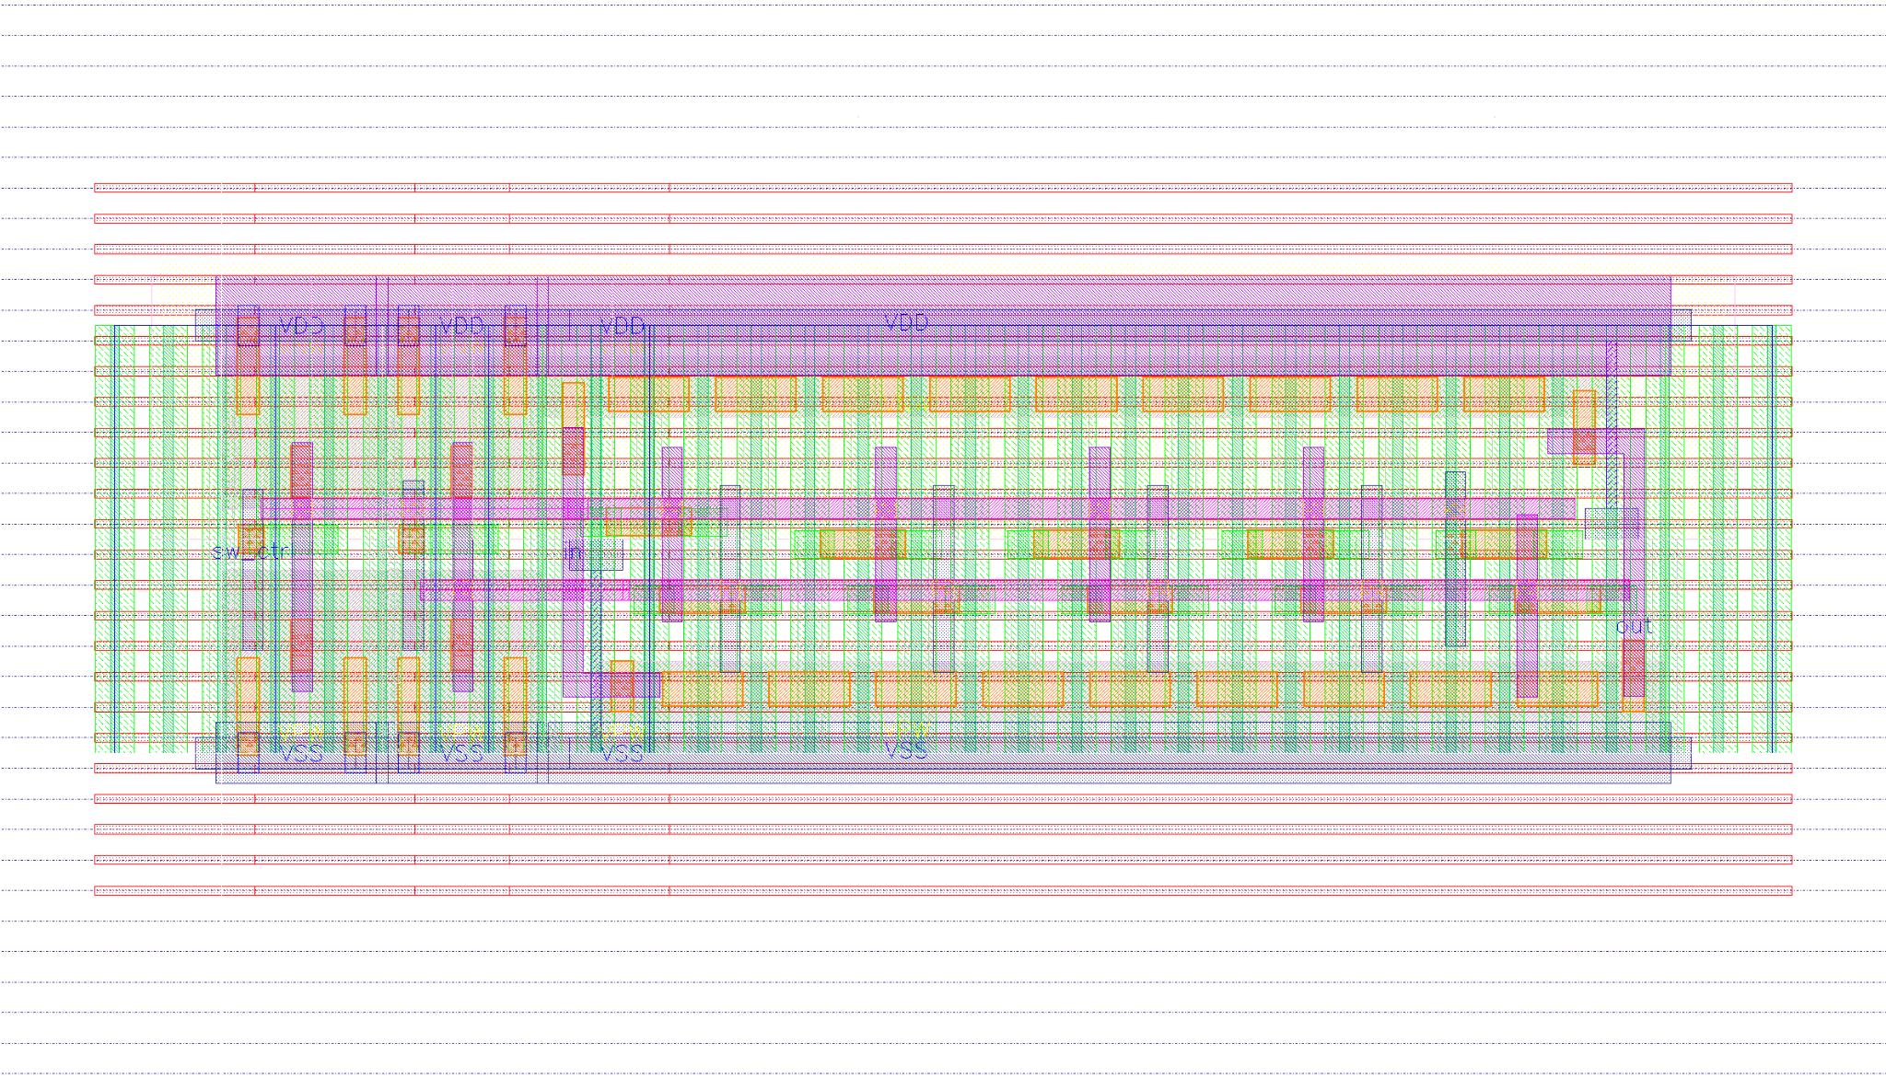

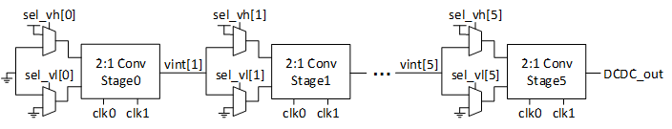
Generated Analog into Digital design flow
FASoC Generator
SAR ADC Block Diagram
ISSCC-2015
Temperature Sensor
D-LDO
Automated
Manual/Custom
ISSCC-2017
CICC-2010
PLL
DC-DC Converter
Automated Custom Layout Generator
Notes:
When we add the auxiliary cells we make sure they are laid out following the standard cell grid . We show here in the bottom a couple of layout examples.
We also like to call fasoc’s approach vlsa that would stand for very large scale analog (which is a play on vlsi). In fact the use of verilog to describe analog designs makes the flow easier since we will ride on the highly automated digital flows

Slide 6
Now proprietary or open source design flow
SAR ADC Block Diagram
Temperature Sensor
D-LDO
OpenFASoC!
Automated
portable
analog
PLL
DC-DC Converter
Automated
Manual/Custom
Notes:
On the other side, OpenFASOC relies heavily on OR, in addition to a set of other tools like Yosys/abc for logic synthesis, we recently started using the surelog/uhdm plugins to yosys integrated by antmicro and Google to add the system verilog support.
Magic, netget for DRC and LVS - we have added KLayout recently which it appears to be a very powerful tool for layout viewing and LVS/DRC checks. Think about a nice calibredrv with low latency and python based APIs with really nice GUI

Slide 7
Now proprietary or open source design flow
SAR ADC Block Diagram
Temperature Sensor
D-LDO
PLL
DC-DC Converter
Built on top of open-source silicon tools and PDKs
Automated
Manual/Custom
Notes:
On the other side, OpenFASOC relies heavily on OR, in addition to a set of other tools like Yosys/abc for logic synthesis, we recently started using the surelog/uhdm plugins to yosys integrated by antmicro and Google to add the system verilog support.
Magic, netget for DRC and LVS - we have added KLayout recently which it appears to be a very powerful tool for layout viewing and LVS/DRC checks. Think about a nice calibredrv with low latency and python based APIs with really nice GUI

Slide 8
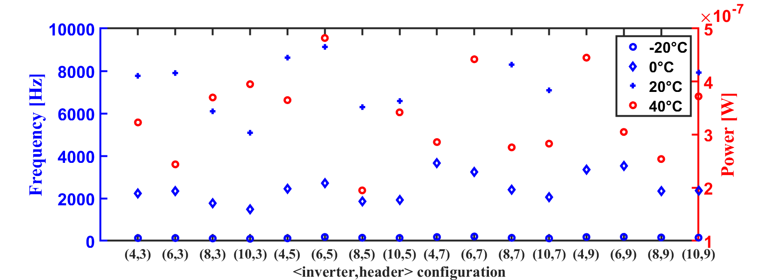
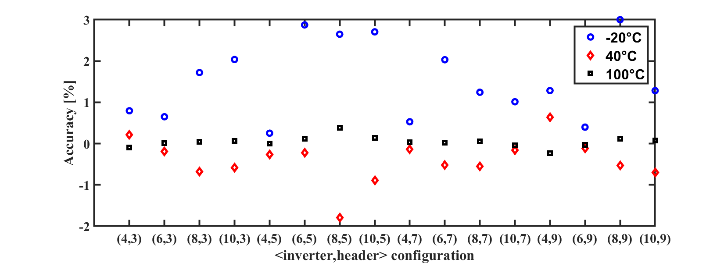

Open-Source EDA Workflow
Streamlined development and distribution with reproducible results
Express Dependency Installer vs. Lightweight Docker Build
Reproducible Results, Jupyter Notebooks
Installation paths
Checkout Repository
Build a local docker image using docker/conda/Dockerfile
conda-eda Packages
dependencies.sh
docker build
open_pdks
SKY130
GF180
conda install
Install EDA tools and open PDKs
image
pull
Docker Hub
pip install
Python libraries for visualization and computation
push
magic
commit
run
Build ngspice, xyce
Install SPICE simulators from source
Pull latest stable image
netgen
container
openroad
Klayout
Install Klayout for DRC
CI
yosys
Cloud Runner
Repository of EDA tools and PDKs
One-click dependency installation script
Reproducible, Reusable
Jupyter Notebook
Notes:
Now actually we can pipe install tools and Process Design Kits on your laptop which drastically lowers barrier to entry
No need for NDA

Slide 9
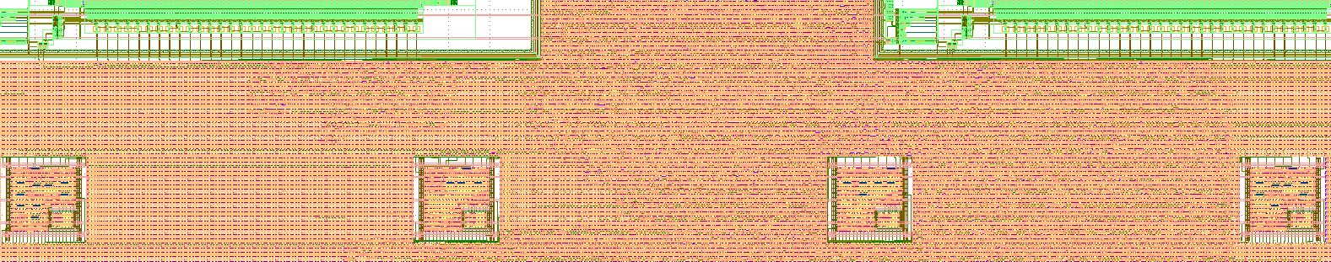
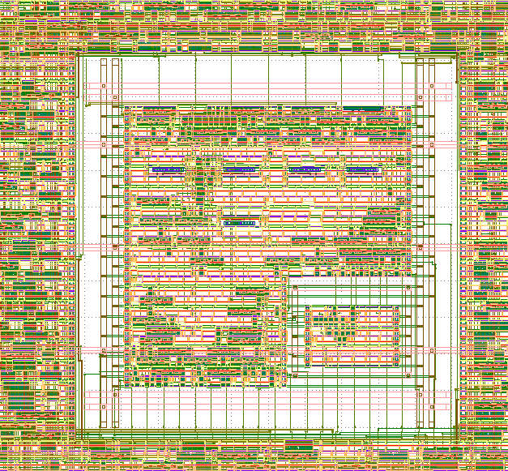
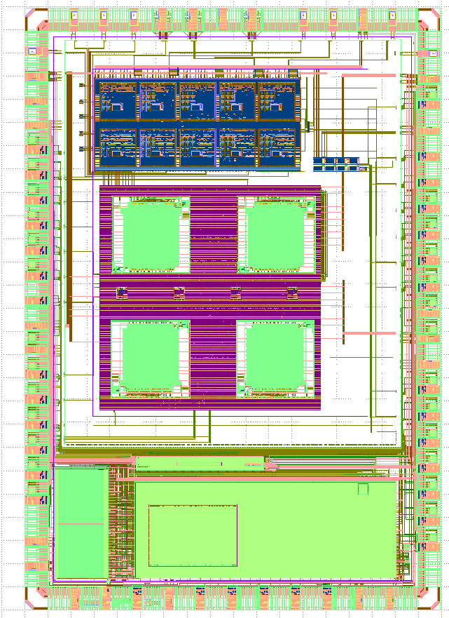
Integrated Temperature Sensors in Sky130
Highly tunable V_{REF} with trimming bits
Sensing elements are sitting on a second voltage domain
µP with Embedded Temperature Sensors
The temperature sensor generator uses a fully open source flow
Notes:
We have integrated 4 sensors connect to the opentitan’s IBEX core through tilelink.
As you can see we were able to create voltage domains and had the sensing elements of the temperature sensor generator sit on a separate area with its own on-chip generated voltage.
Non default rule have been also enabled in OR, we added on top of that py scripting to connect custom nets to power rings which you can see on the left which is essentially doing special routing
All of these features are expected to be included directly in the OR database. And this model seems to be working great following the software model with a lot of iterations and improvements.

Slide 10

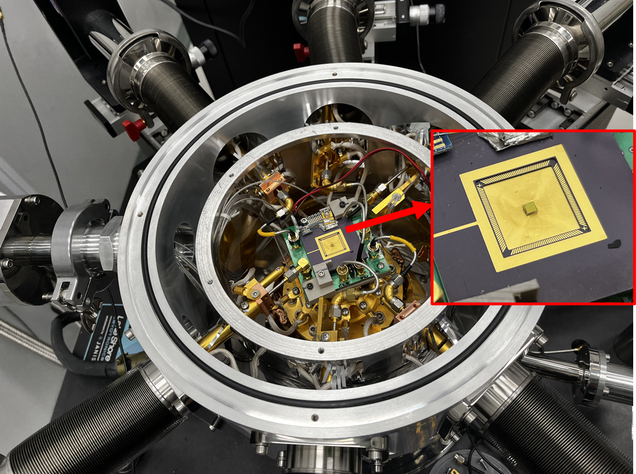
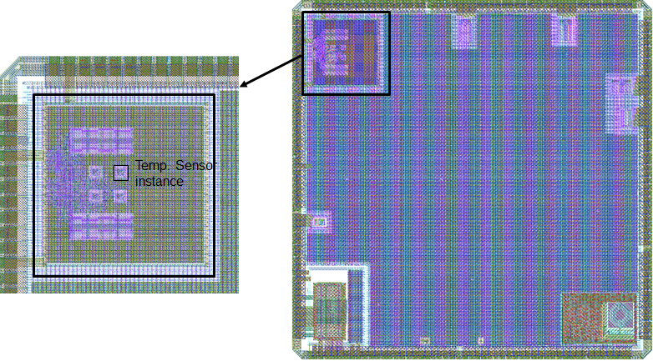
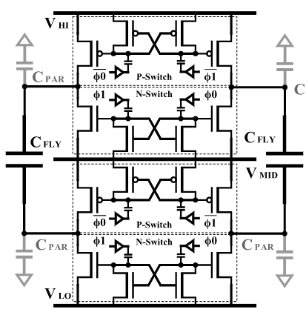
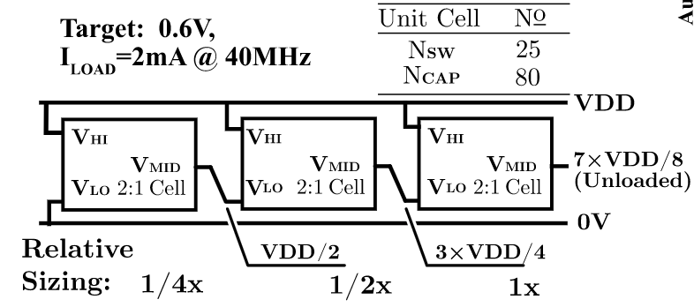
Applications of Block-Based Automation
Switched-Capacitor Ultra Wide Temperature Range DC-DC Converter
>75% Efficiency from 398K to 23K
Programmatically Generated for arbitrary design targets.
[IEEE SSCL, Vol. 7, 42-45]
….
Jun
Dec
Aug
Oct
Dec
Feb
Apr
Jun
Aug
Oct
Dec
Feb
Apr
Jun
Nov.
2020
2021
2022
2023
2024
Notes:
As part of the DARPA IDEA program, we were able to utilize a gf12lp shuttle to create prototypes using open tools. Our team successfully designed the first version of the opentitan RoT, which included temperature sensors that were developed using oepnfasoc.
And with Prof Wentzloff, we have built a Bluetooth transmitter where the ADPLL uses fASOC with a coarse/fine grain embedded TDC and vernier delay line TDC to reduce fractional spurs

Slide 11
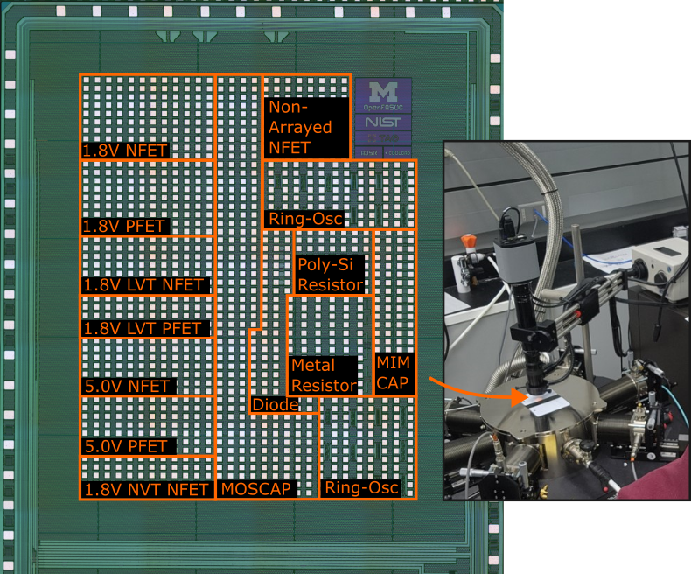
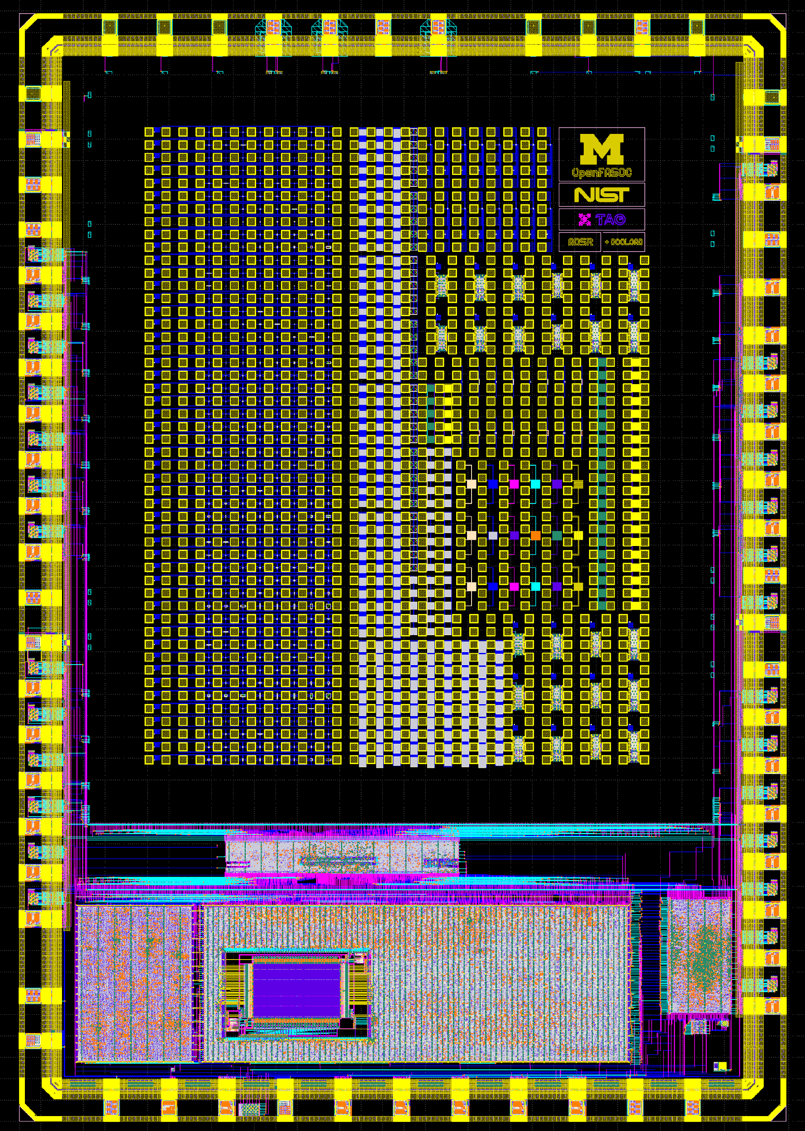
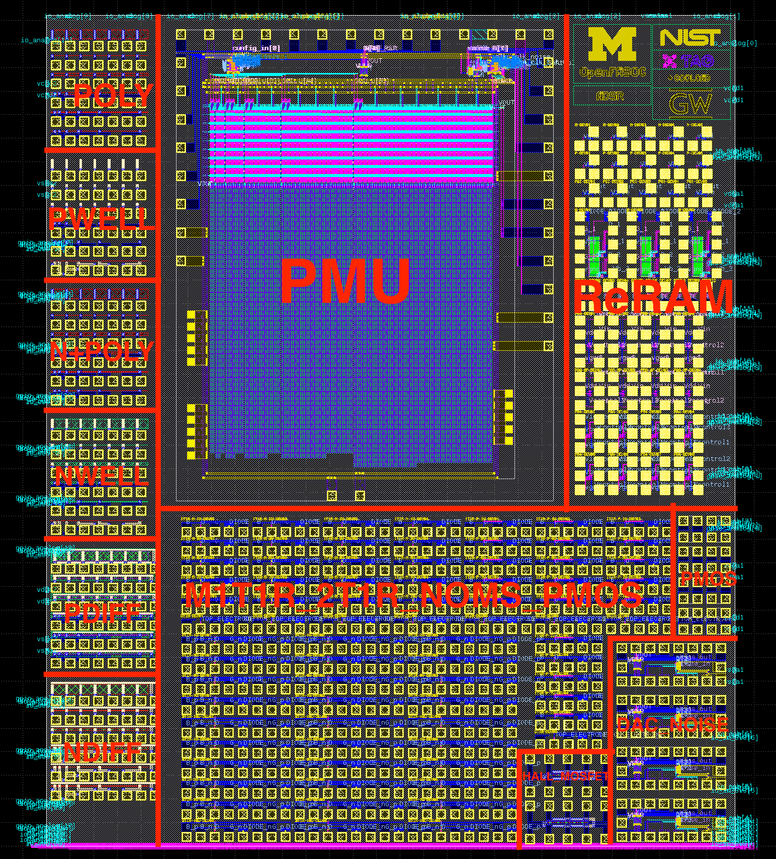
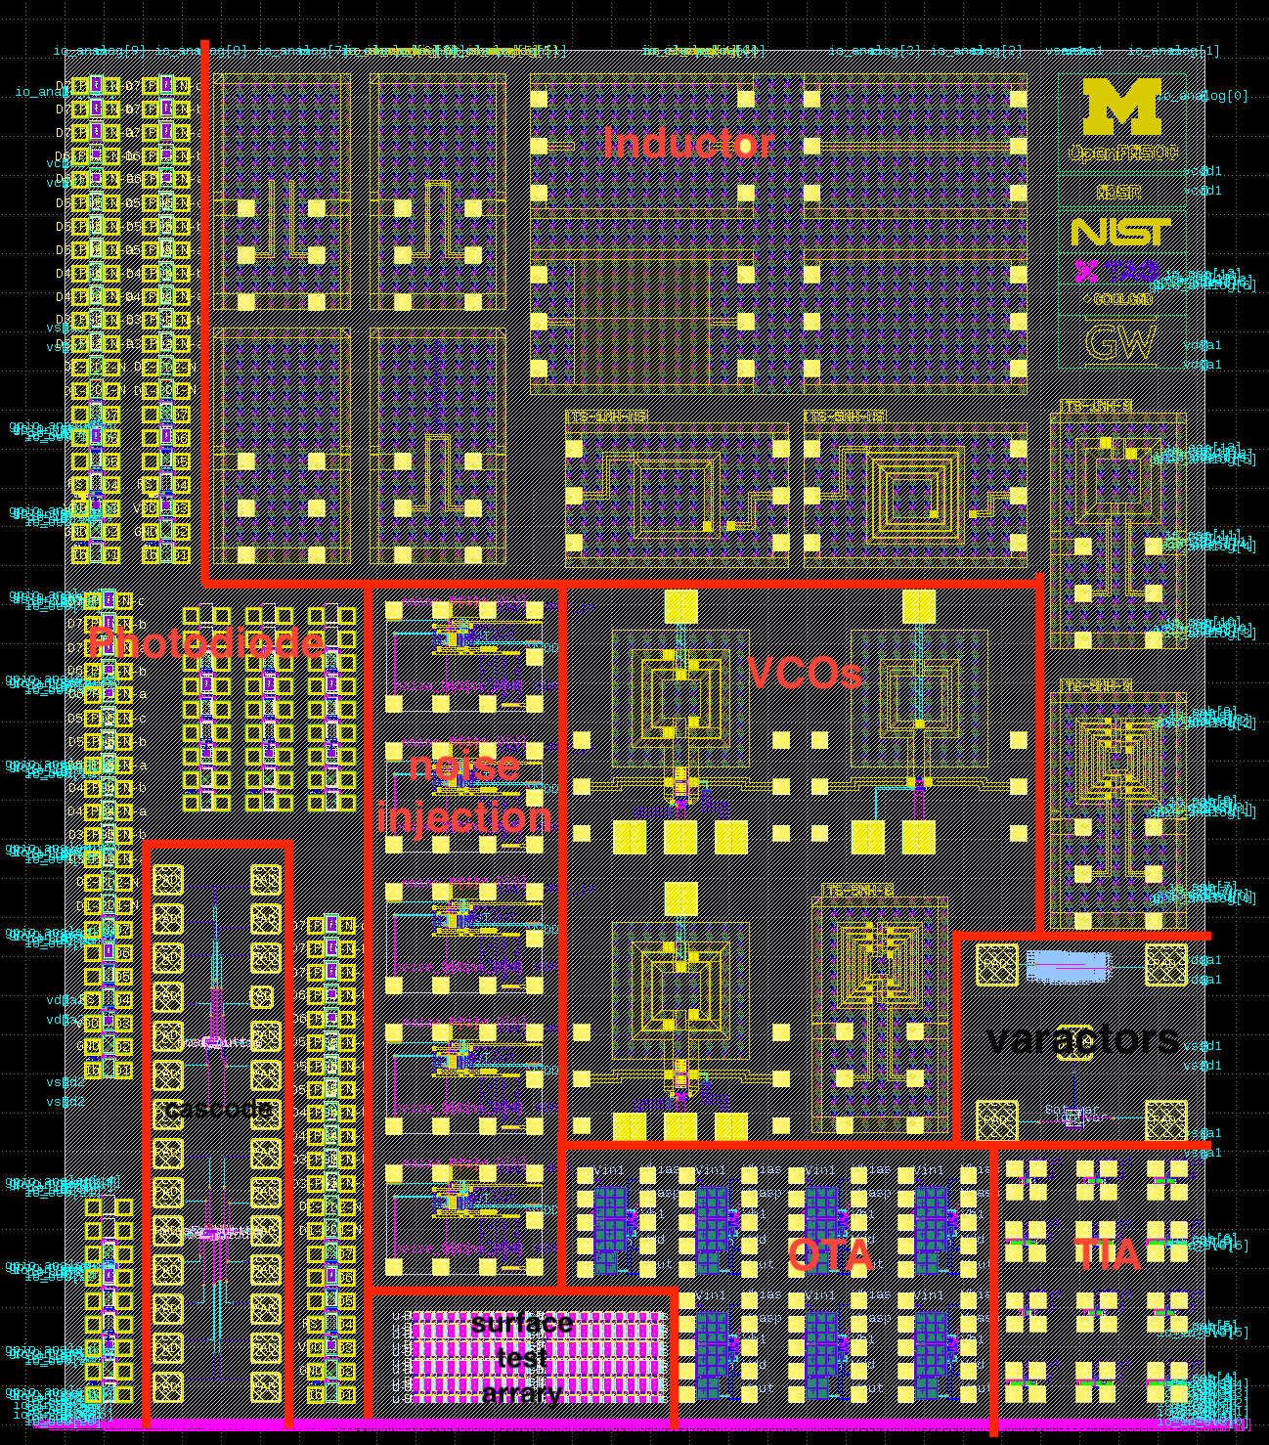
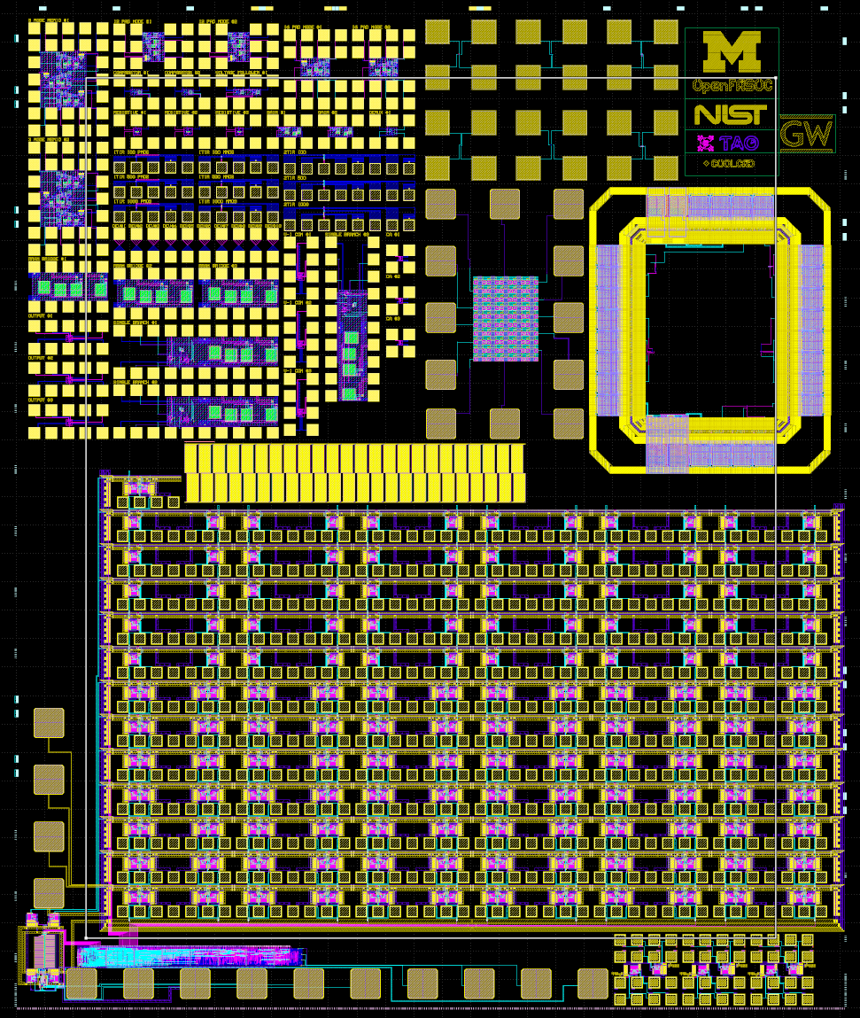
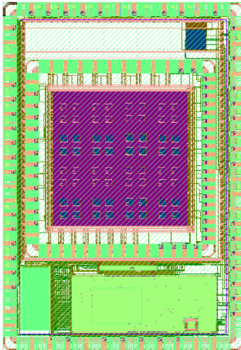
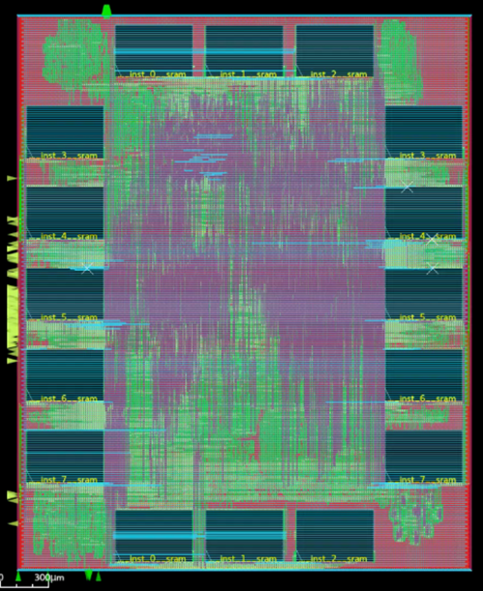
Applications of Block-Based Automation
Device Test Structures for CMOS+X Research
Skywater 130nm MPW 5~8
Structures for Cryogenic device characterization (MPW5):
https://data.nist.gov/od/id/mds2-2997
….
Jun
Dec
Aug
Oct
Dec
Feb
Apr
Jun
Aug
Oct
Dec
Feb
Apr
Jun
Nov.
2020
2021
2022
2023
2024
Notes:
As part of the DARPA IDEA program, we were able to utilize a gf12lp shuttle to create prototypes using open tools. Our team successfully designed the first version of the opentitan RoT, which included temperature sensors that were developed using oepnfasoc.
And with Prof Wentzloff, we have built a Bluetooth transmitter where the ADPLL uses fASOC with a coarse/fine grain embedded TDC and vernier delay line TDC to reduce fractional spurs

Slide 12
GLayout: Our Solution to Parameterized Analog Circuit Generation

Slide 13
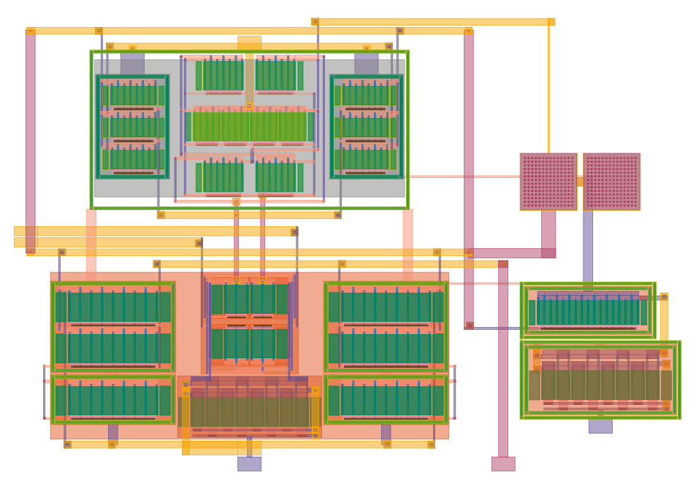
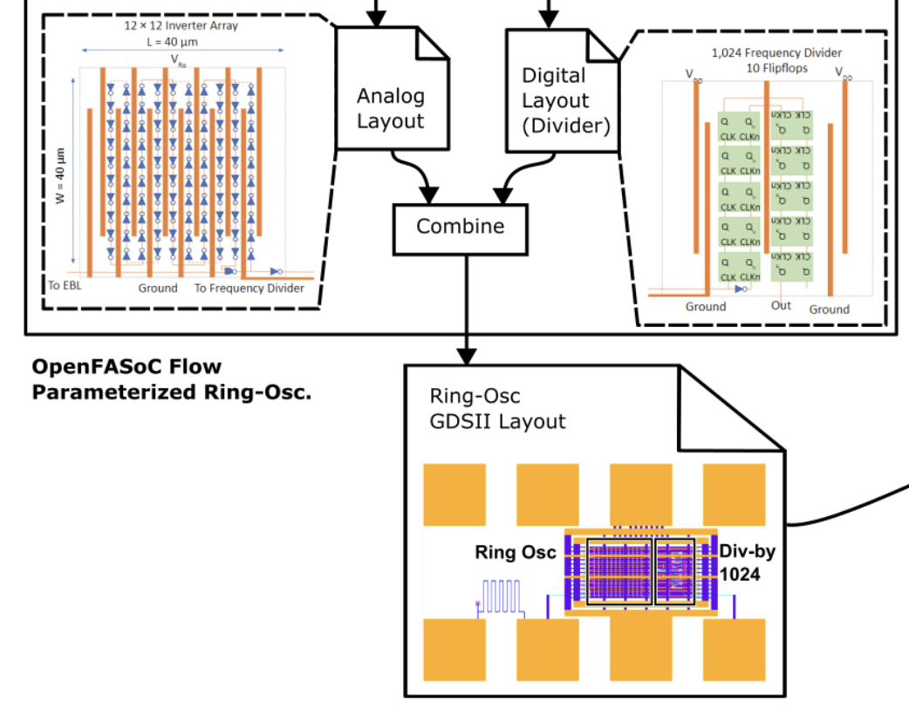
Challenges: Certain Analog Components need Parameterized Transistor-Level Layout
VS
Ring OSC
Grid-based Layout is good enough
OPAmp
Need Transistor-Level Layout
Dummy Transistors …
Common Centroid Placement …
Routing Parasitics…

Slide 14
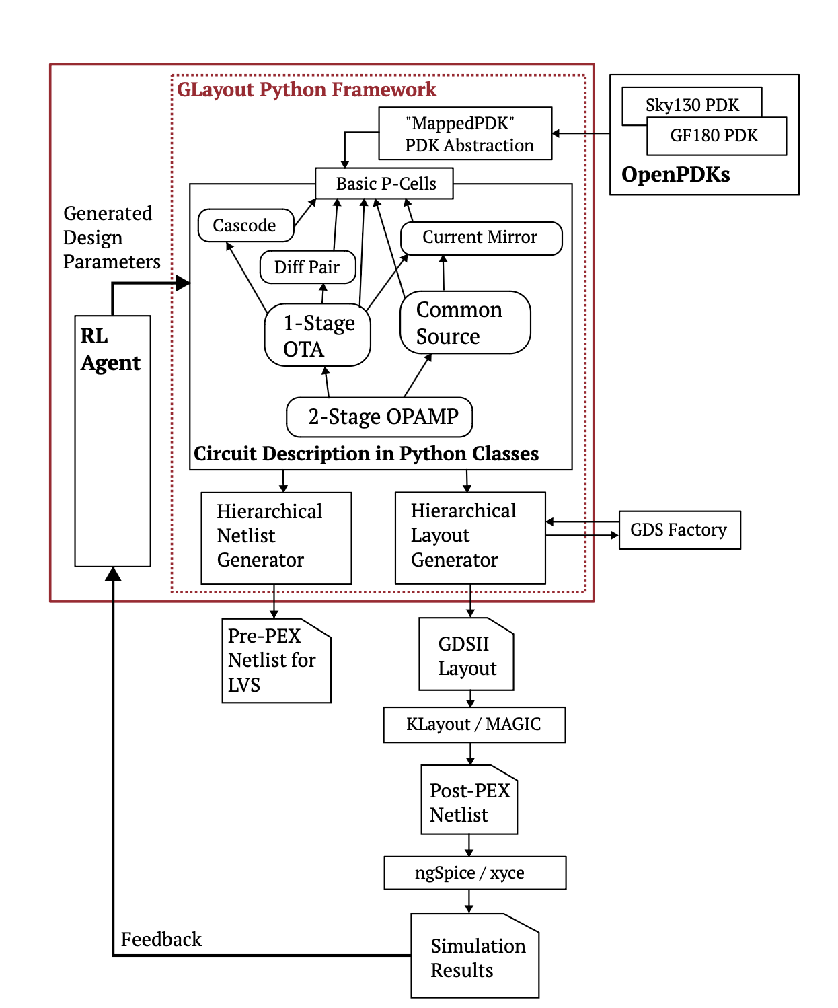
GLayout
Our solution: a python-based
hierarchical circuit generator

Slide 15
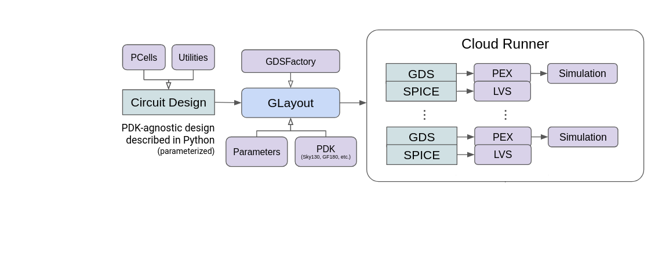
GLayout: A Pythonic Framework for Analog Layout Design
Run >1k designs in parallel
Open source tooling allows us to deploy the generation - simulation flow on 512 CPU cores

Slide 16
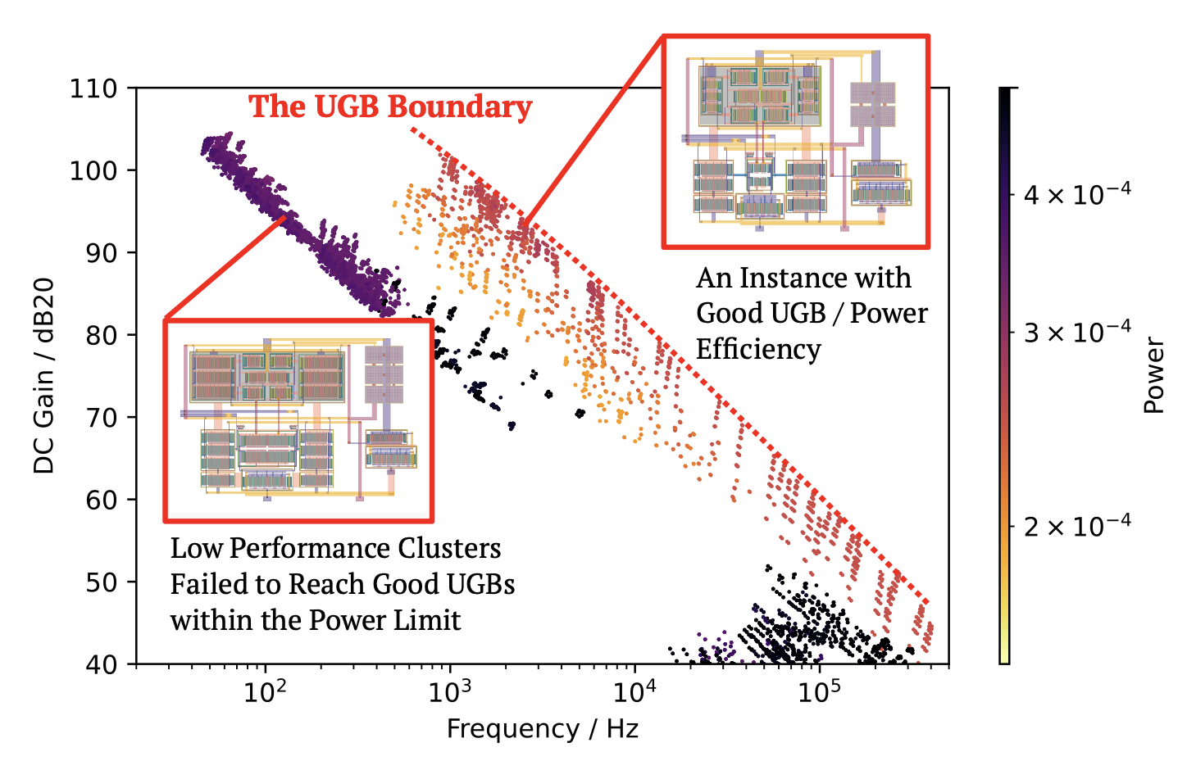
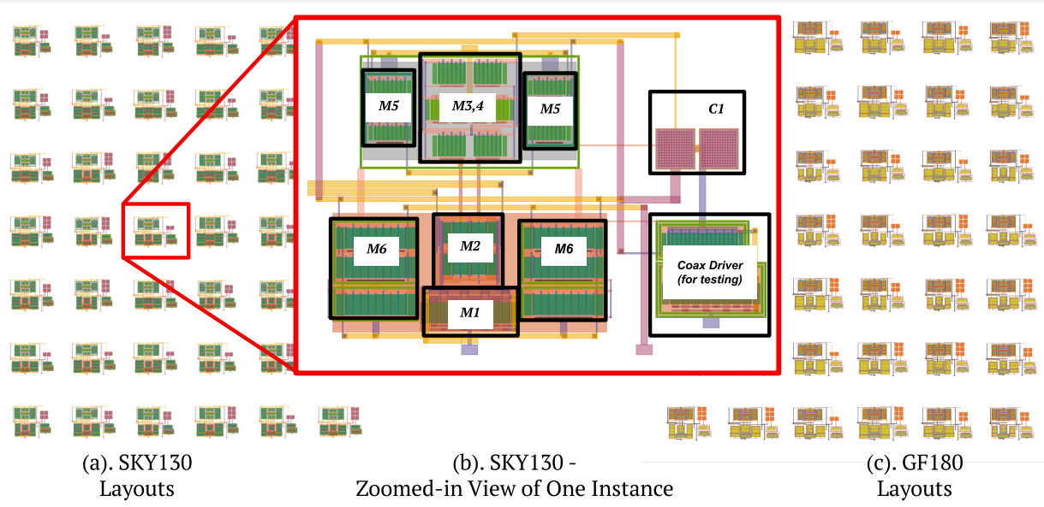
GLayout: A Pythonic Framework for Analog Layout Design
Building a database rapidly using parallel circuit simulation

Slide 17

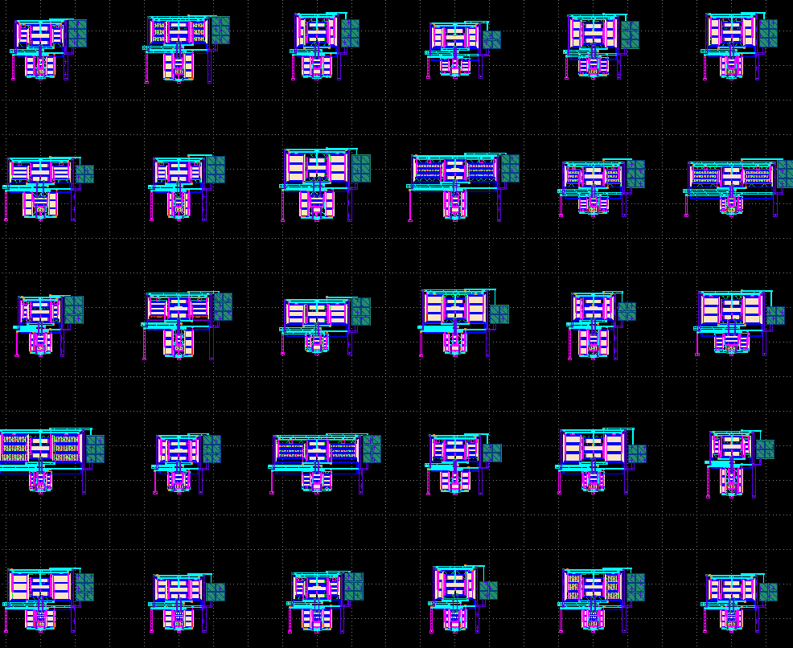
GLayout: A Pythonic Framework for Analog Layout Design
GLayout is built using only open-source tools and PDKs
Can be deployed on your local machine or a cloud server with no restrictions.

Slide 18
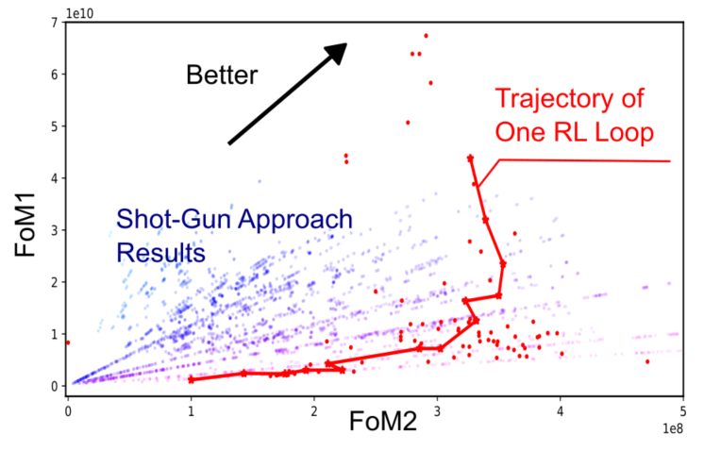
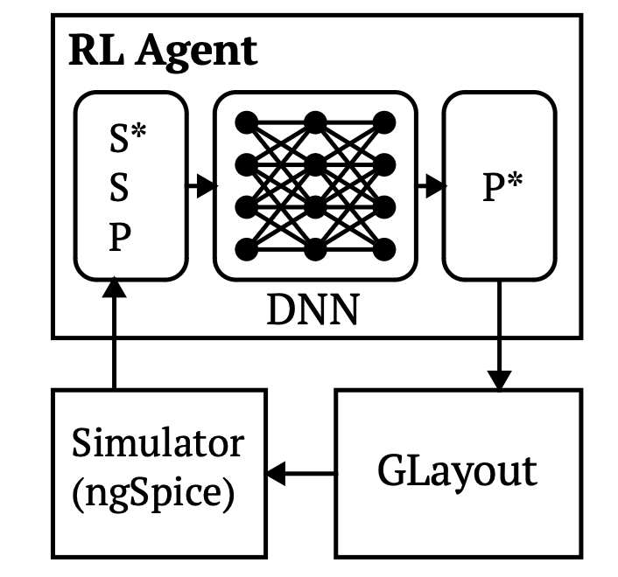
Data-Driven Design
Combining ML with circuit design requires a lot of data
The generator is a powerful tool for generating Synthetic Data.

Slide 19
Applications of Glayout
In Customized Design

Slide 20
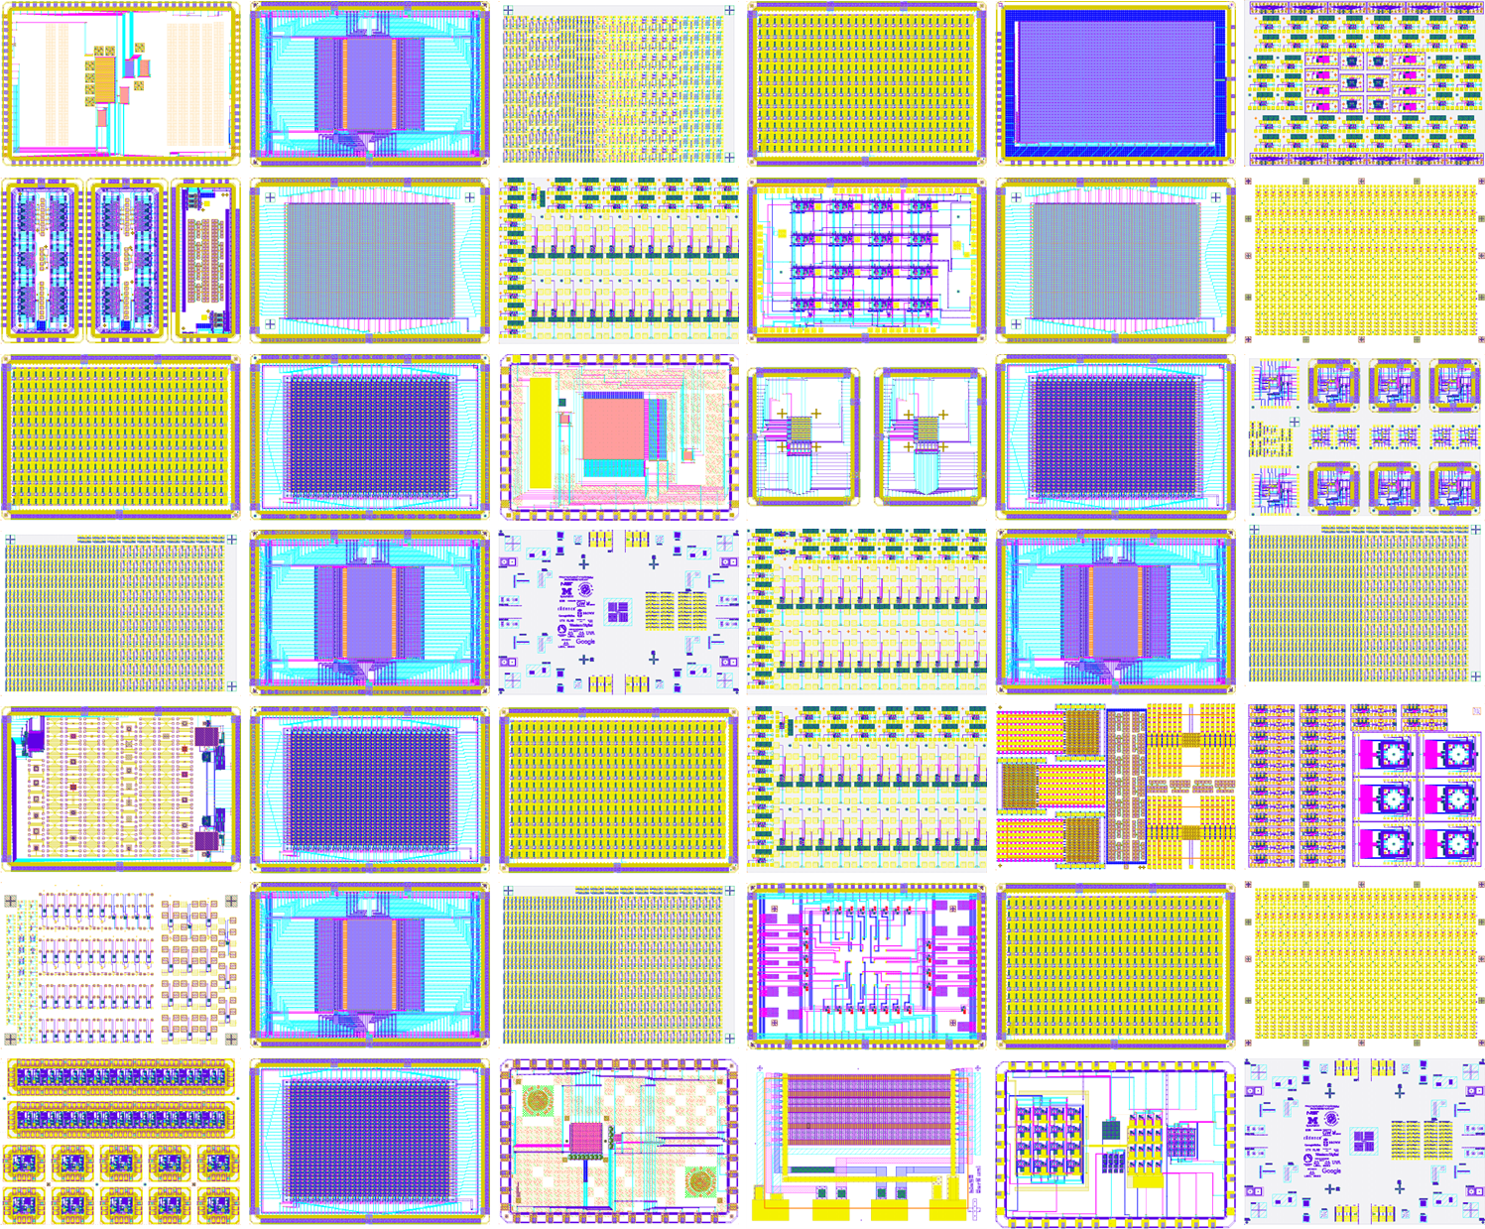
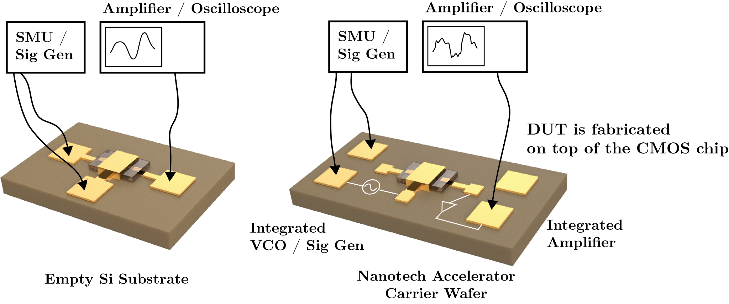
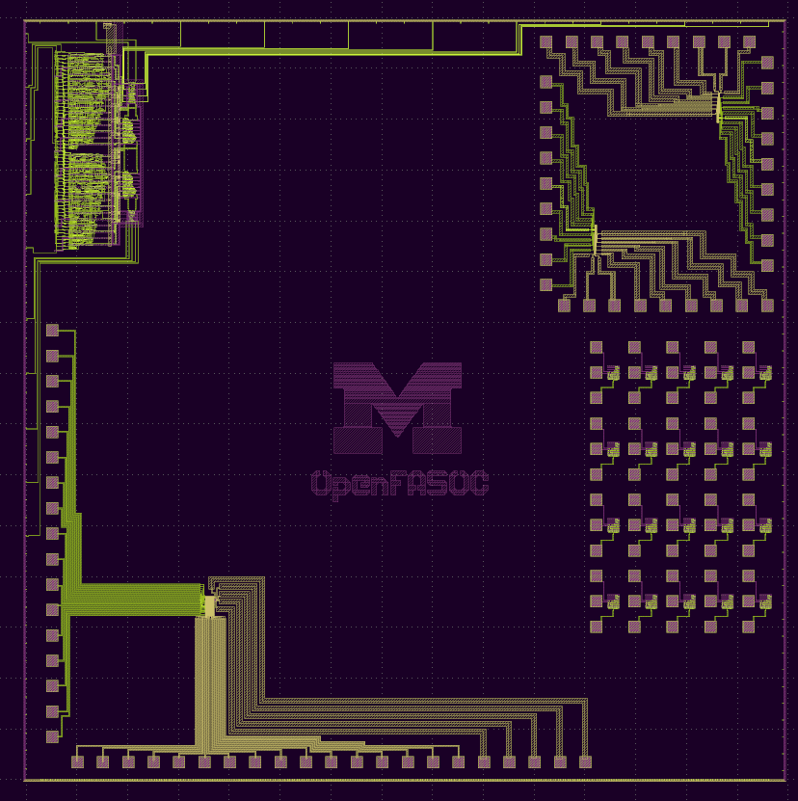
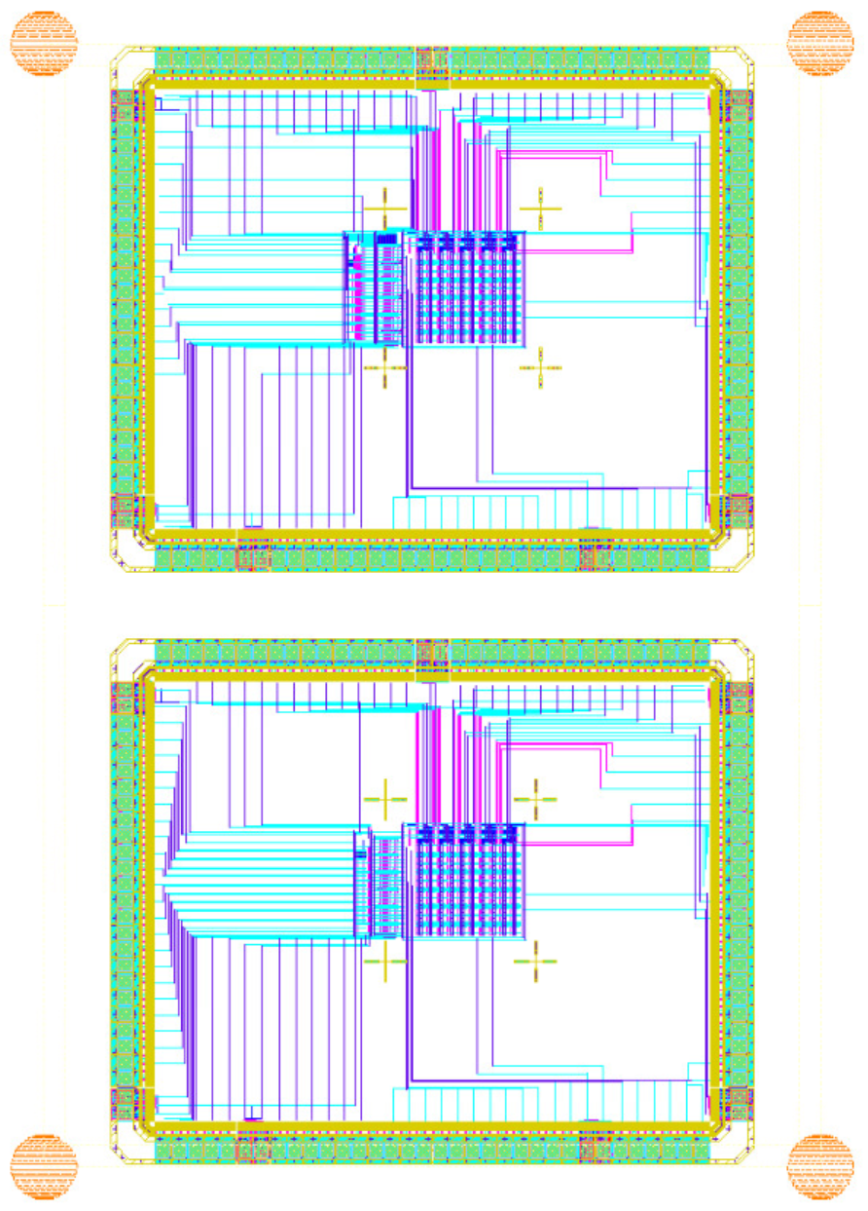
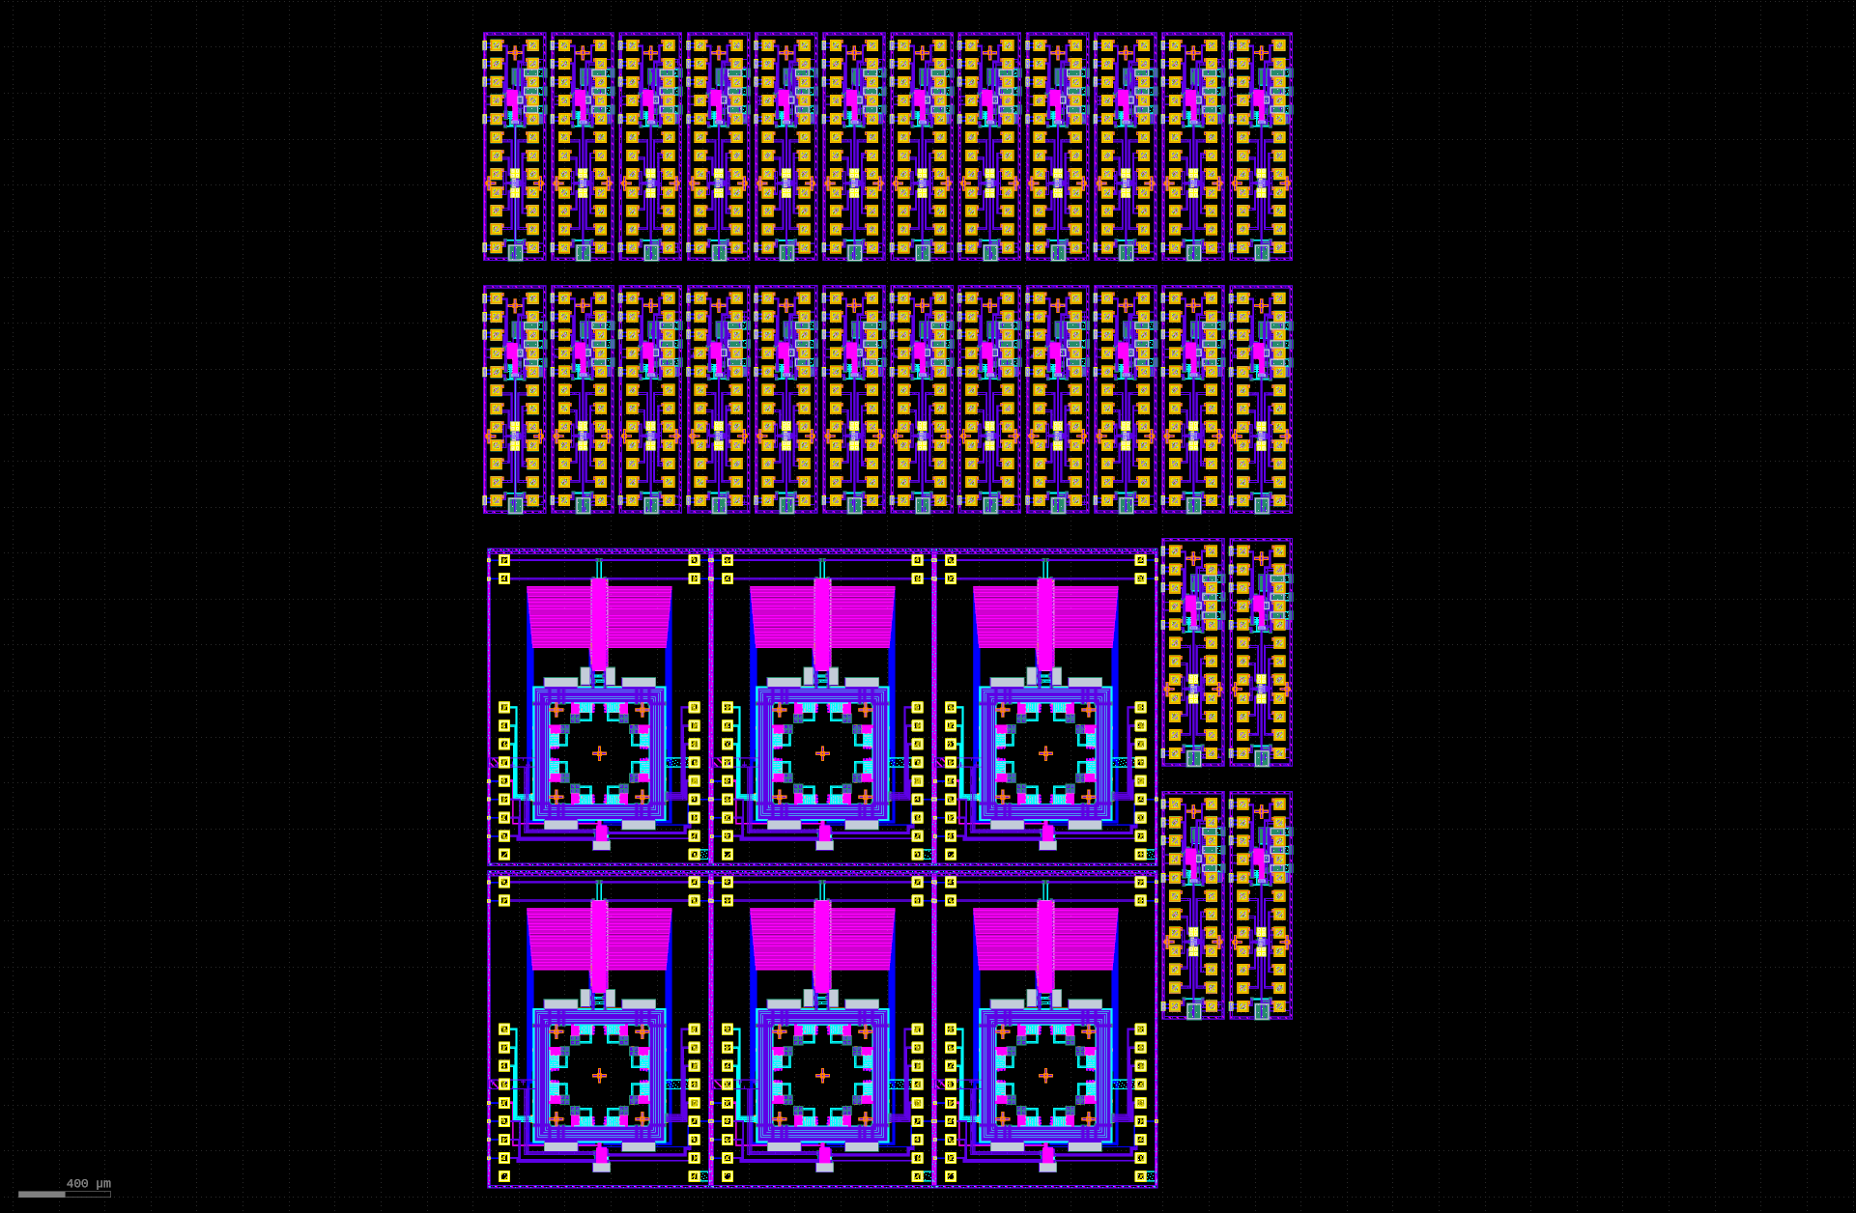
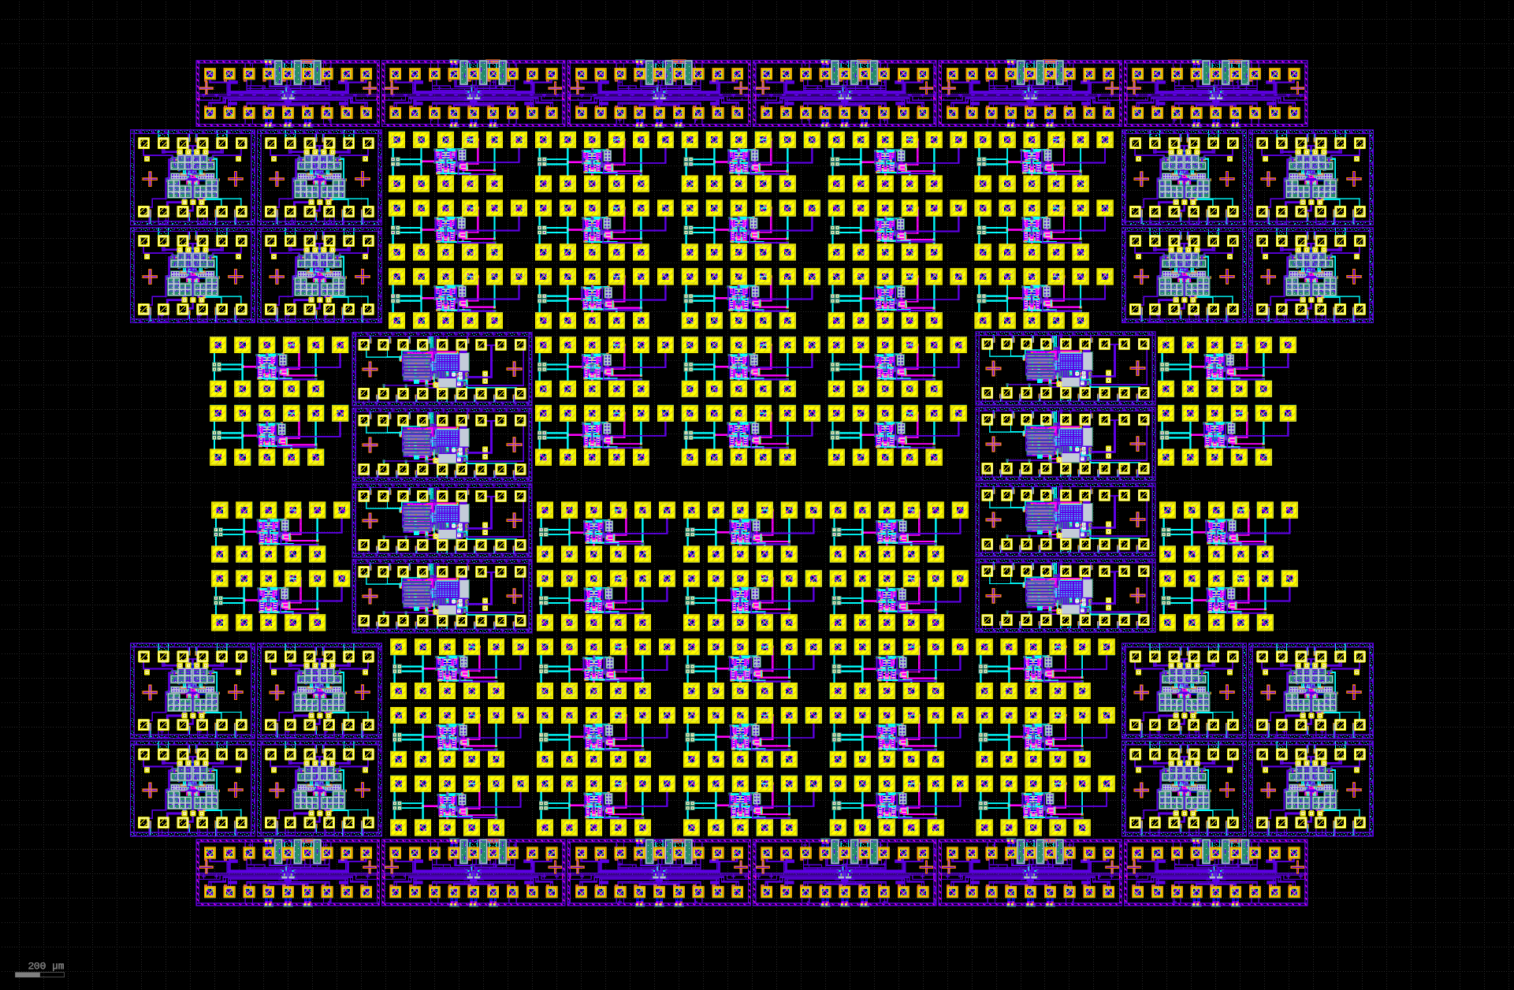
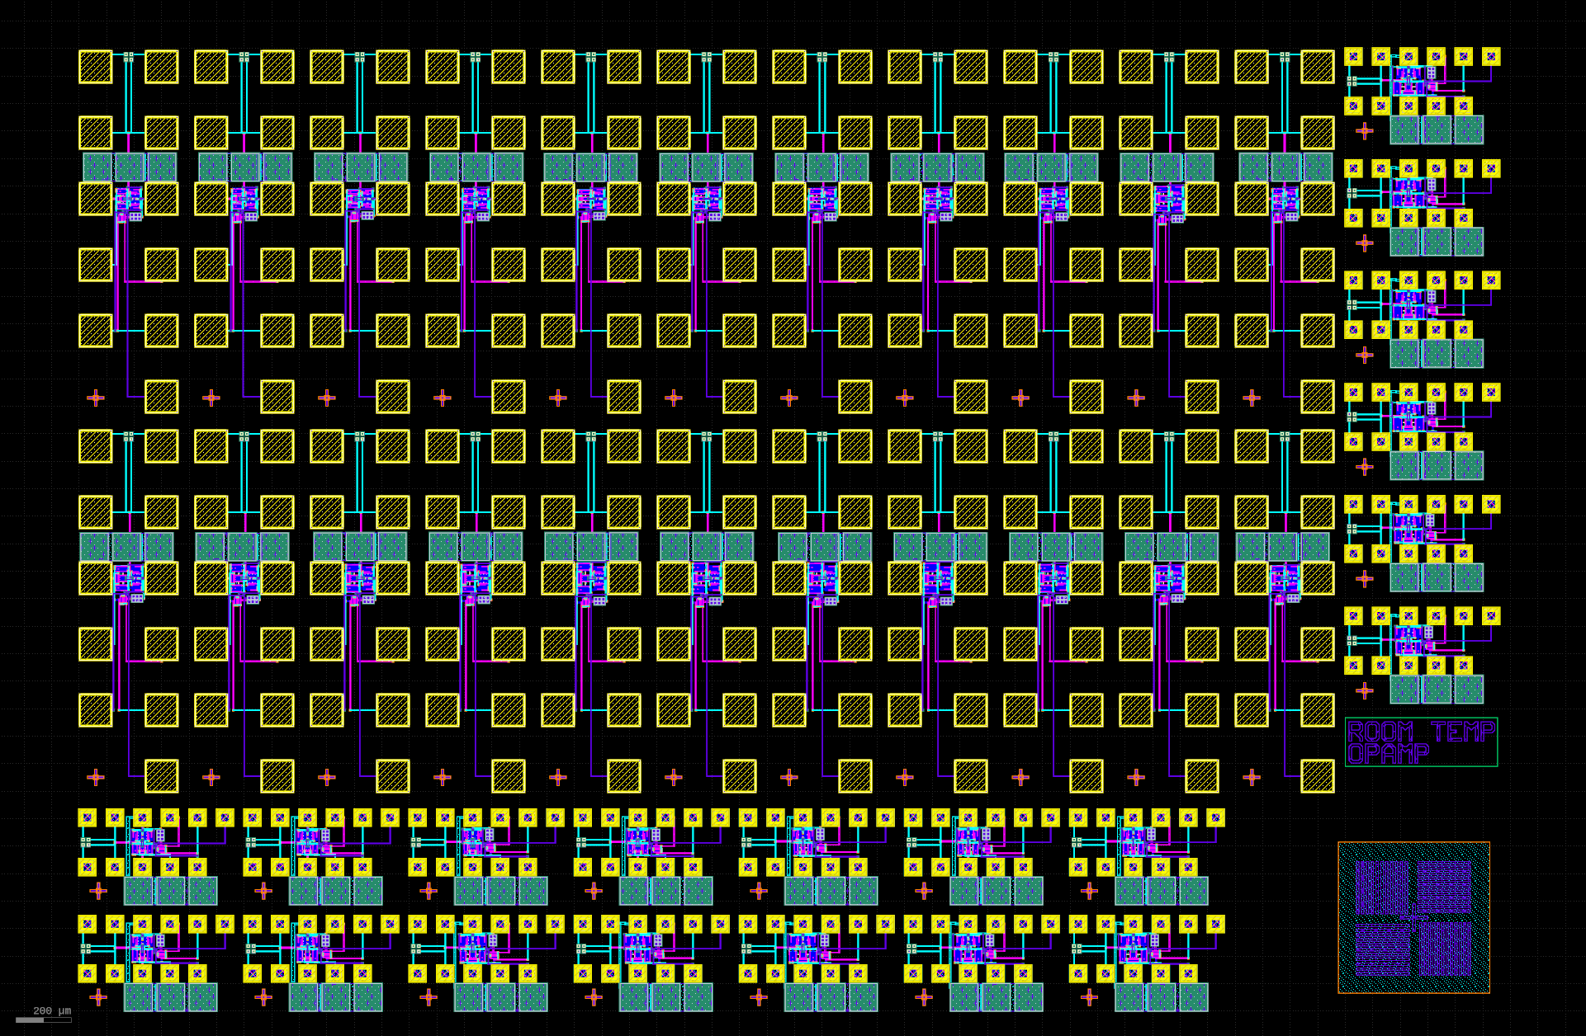
Nanofabrication Accelerator
Device Test Structures for CMOS+X Research
Nanofabrication Accelerator project
A wafer-scale active substrate for metrology and novel device research
30 unique tiles submitted by 10 Universities and institutes
….
Jun
Dec
Aug
Oct
Dec
Feb
Apr
Jun
Aug
Oct
Dec
Feb
Apr
Jun
Nov.
2020
2021
2022
2023
2024
Notes:
Back to the nanofabrication accelerator program, We have put some test apparatus on a silicon chip, which will be used as the carrier wafer for new nano device fabrication. This leads to improved measurement quality and test due the reduced parasitics
we have contributed to 4 shuttles already, each had novel circuits.
And my understanding, Based on information from my colleagues at NIST, it would take over a year to design simple circuits by just porting them onto a shuttle., without even considering novelty,

Slide 21
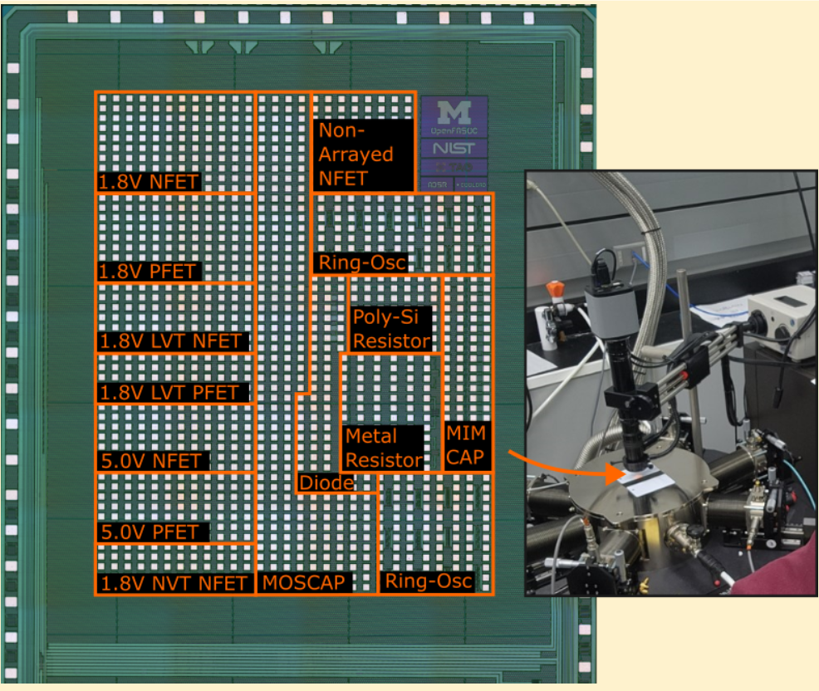
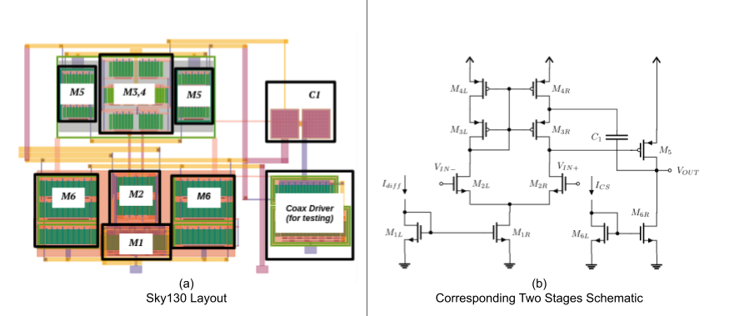
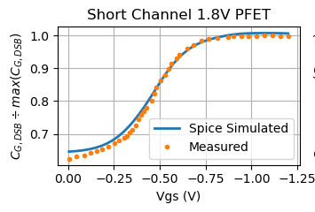
Making OPAmps for Cryogenic Applications
Circuit Design
Silicon Measurement
BSIM Model @ 4K

Slide 22
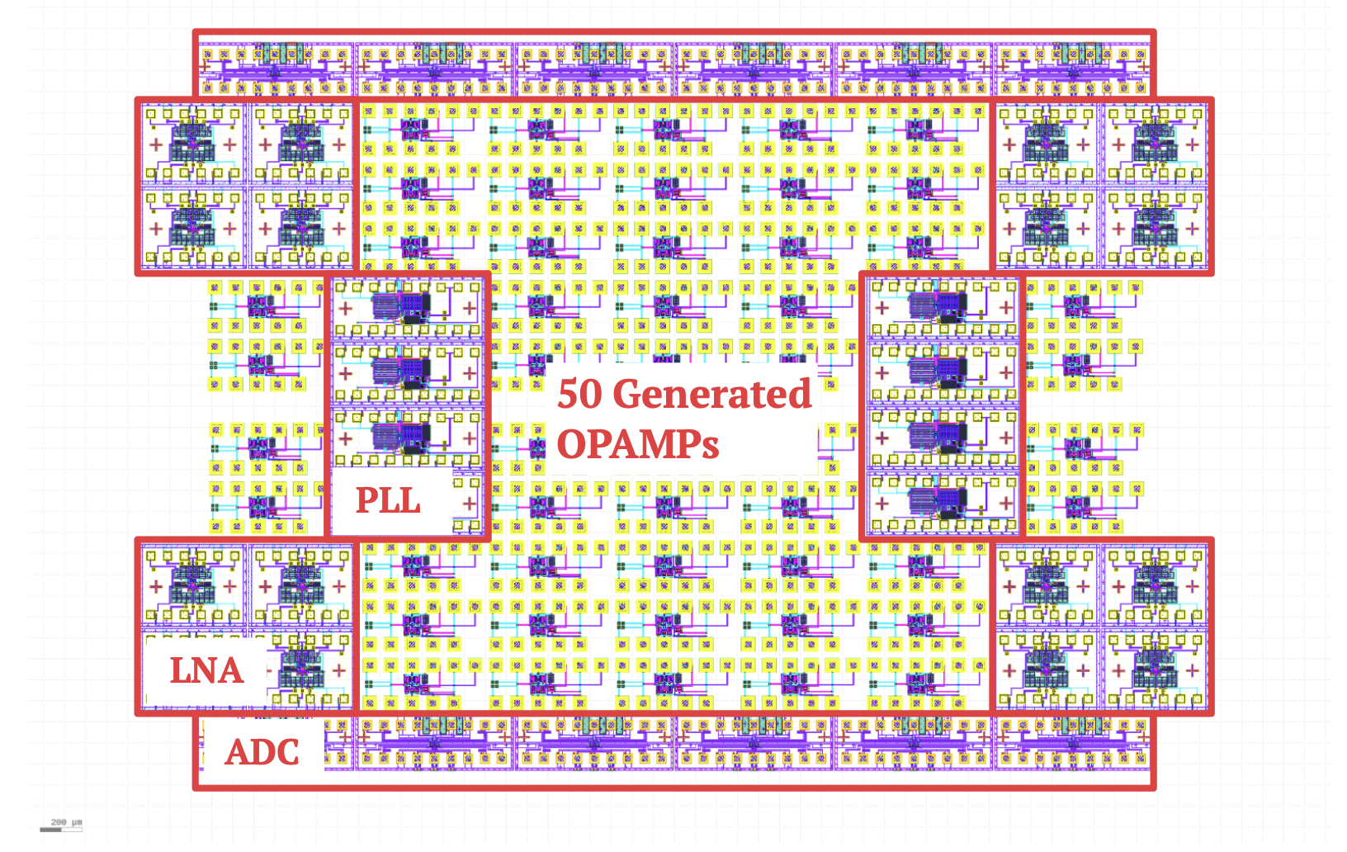
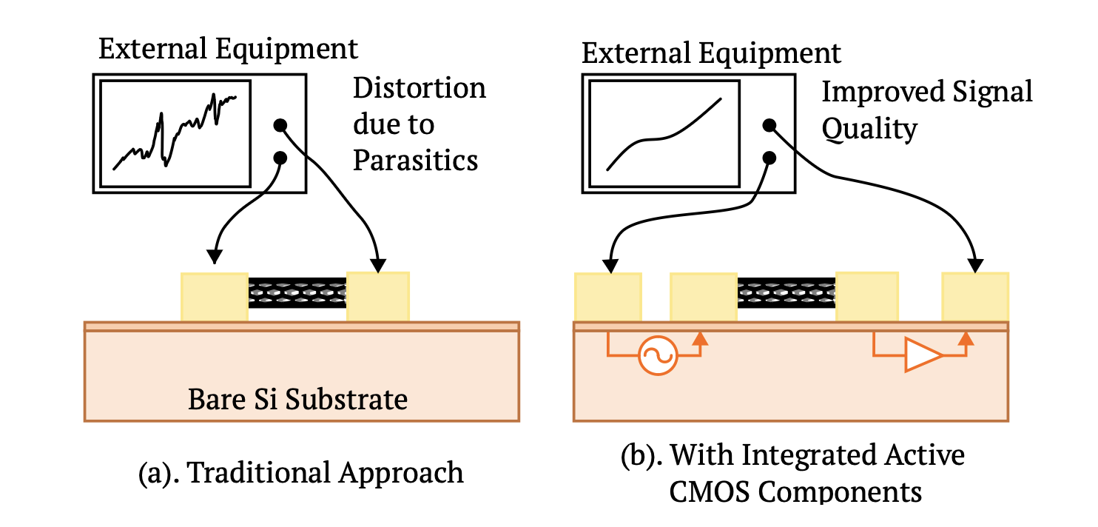
A Tile of 50 Different OP Amps for Nano Fabrication Experiments
Tapeout in SKY130
Use custom metalization to build desirable circuits

Slide 23
GLayout Setup
&
Design Walkthrough

Slide 24
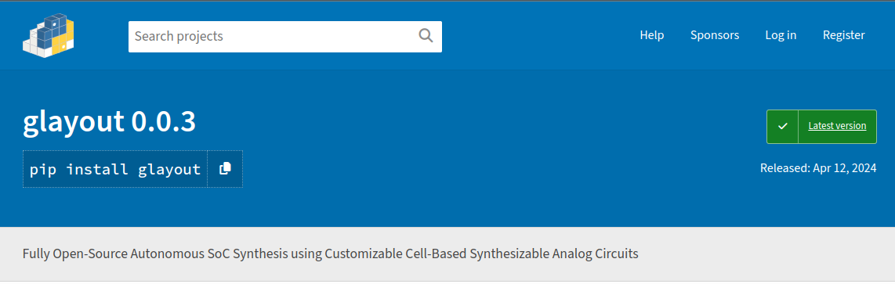
Environment Setup
GLayout is published as a PyPI package.
Users can download it automatically using Python’s package manager
https://pypi.org/project/glayout/
We will have tutorial videos on Youtube. Subscribe and stay tuned
https://www.youtube.com/@fasoc

Slide 25
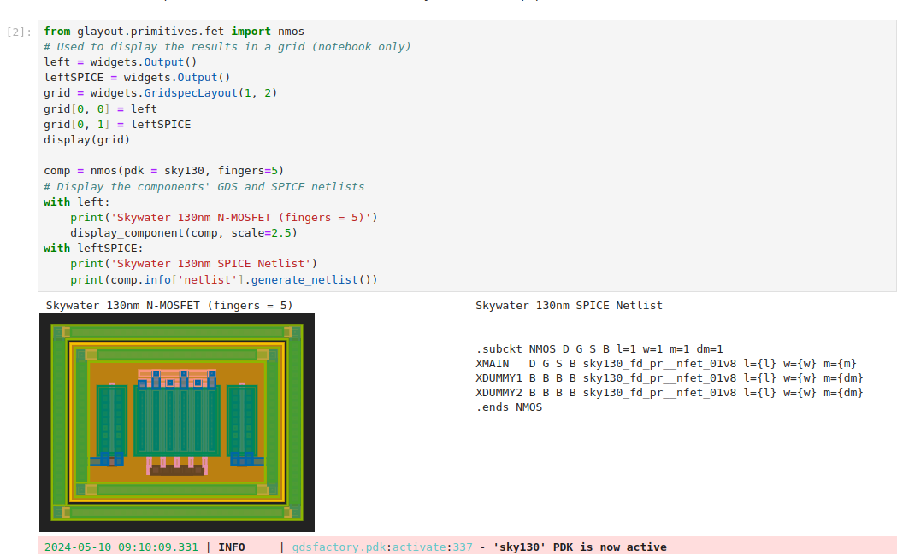
Demo 1: Overview of the Primitives
Glayout_1_overview.ipynb
Execute the code on your local machine or

Slide 26
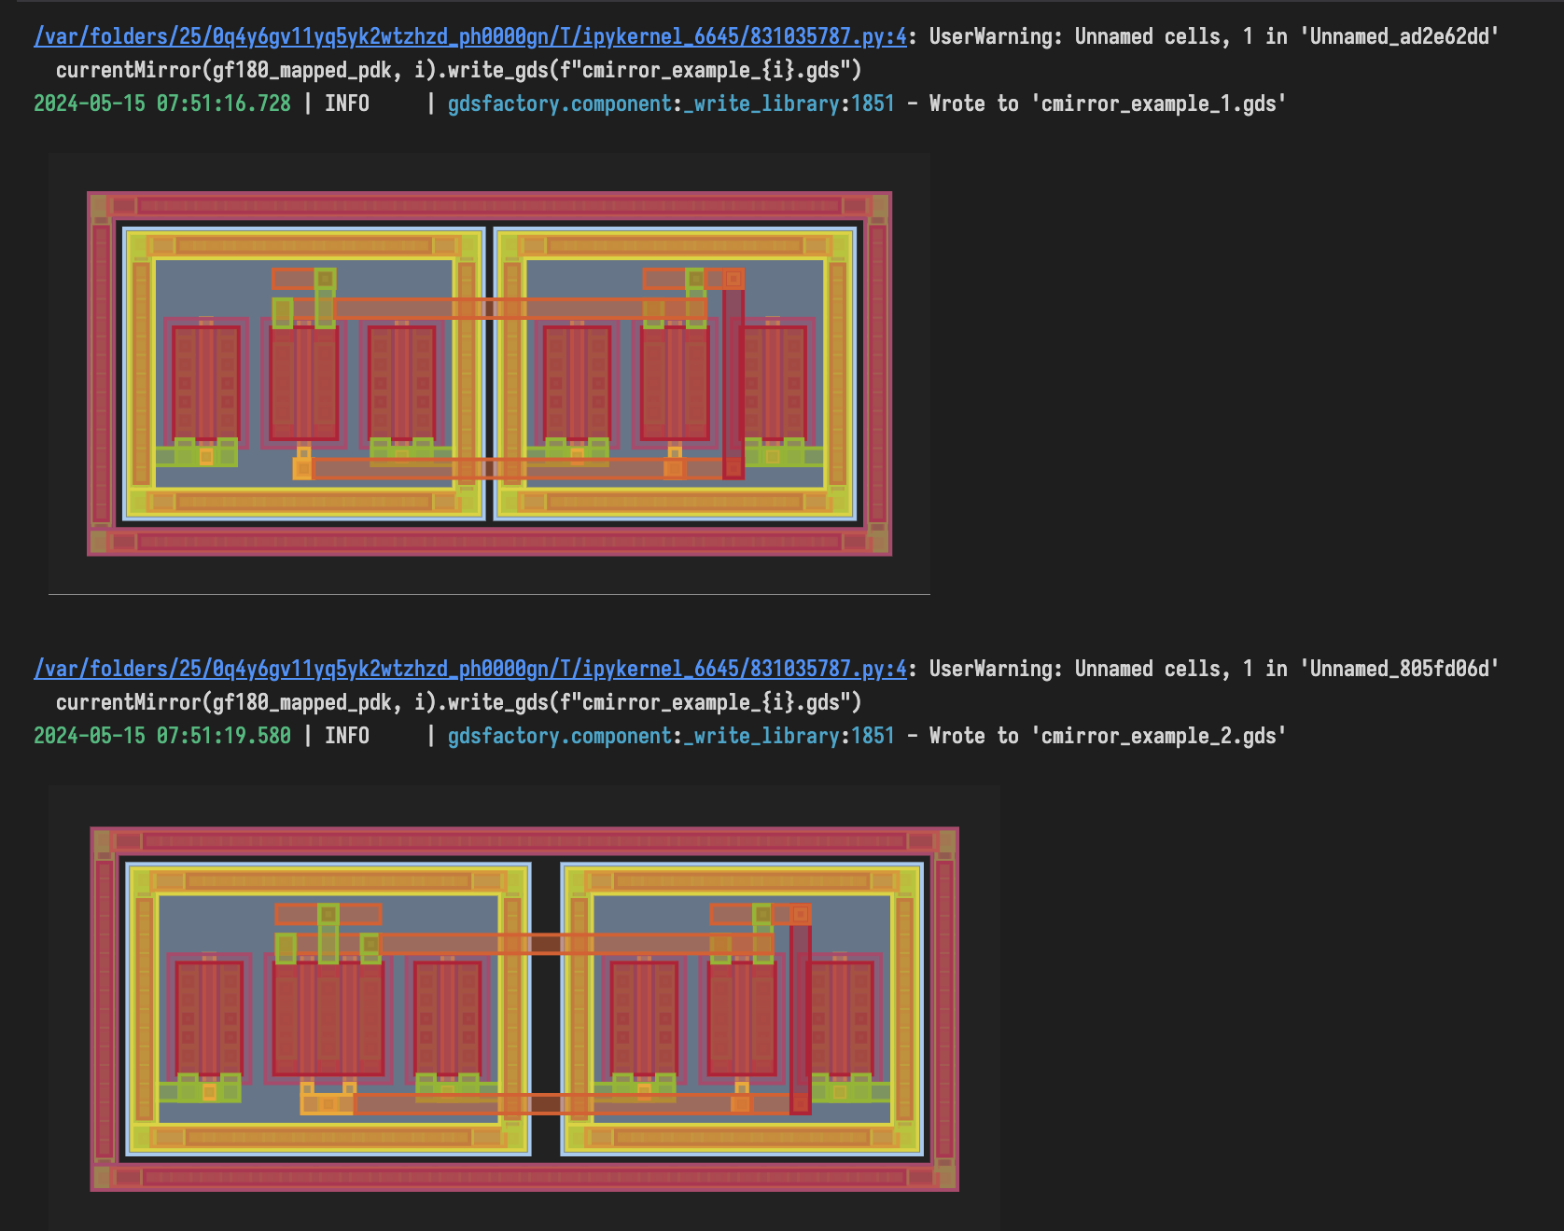
Demo 2: Building a Current Mirror, Step-by-Step

Slide 27


Demo 3: An OPAmp Generator with Simulation Flow
Construct a rich database containing 8000 different designs in 5 hours

Slide 28
Thank You !

Slide 29
Open-Source EDA Workflow - Cloud, CI, etc..
Cloud Based CI System
Feature Improvements and Bug Fixes with Github Actions
OpenFASoC GitHub Repository
Cloud CI Runner
Workflow triggered after every change
PEX
Simulation
Design 1
Flow
DRC
LVS
git pull
git push
PEX
Simulation
Design 2
Flow
DRC
LVS
Local Development Environment
. . .
PEX
Simulation
EDA Tools
Developer Tools
Design N
Flow
DRC
LVS
Cloned OpenFASoC Repo
Automated parallelized verification of each design
Developer makes changes locally and pushes to the repository
Notes:
Discuss how the workflow or contributions happen

Slide 30

OpenFASOC’s GLayout Framework
On Cloud, Fully Pythonic Analog Layout & Netlist Generation
Thorough simulation of 10000 opamp takes only a couple of hours!
Notes:
Mapped PDK
Common python layer

